Slide 1
Children Coping with the Death of a Loved One
Peggy J. Miller
University of Illinois at Urbana-Champaign
1

Slide 2
Overview
Why study children’s experience of death?
Traditional approaches
Problems with current perspectives
Research project: how death is socialized
Conclusions

Slide 3
Why Study Children’s Experience of Death?
Clinical Perspective
  To help children and their parents cope with death of a loved one
  To help critically ill children and their parents cope with the child’s impending death
Cognitive Developmental Perspective
  To gain a better understanding of children’s understanding of biological phenomena
A local tragedy – and the aftermath…

Slide 4
Past Research
Clinical Perspective
Cognitive Dev. Perspective
Focus on:
  Children coping with death
    Loved one / Self
  Emotional aspects
    Dealing with loss
    Fear of death
  Therapeutic setting
Emphasize:
  Lack of cognitive skills
  Lack of emotional / coping skills
Focus on:
  Death in:
    Animals
    Plants
    Puppets
    Humans (in the abstract)
  Educational setting
Emphasize:
  Children’s early emerging conceptual understanding of death

Slide 5
Problems with Current Perspectives
Clinical and cognitive traditions rarely “converse”: emotional and cognitive dimensions not studied together
Cognitive tradition treats death as biological, ignores religious perspectives
Both clinical and cognitive studies ignore cultural context, rarely study how children are socialized re. death

Slide 6
Importance of Cultural Context
Consensus among clinicians: cultural context should be taken into account
American Academy of Pediatrics: providers should offer “culturally sensitive guidance”
Huge differences around the world in children’s exposure to death
Anthropologists: differences in cultural values re. death

Slide 7
Importance of Cultural Context
BUT very little systematic study of children and families from different cultures coping with the death of a loved one
Studies of parental beliefs rarely address beliefs about death

Slide 8
Contextualizing Death: What Needs to be Studied?
Cultural beliefs/practices at the macro level
Cultural beliefs/practices at the community level
  Local experts: clinicians
  Local experts: teachers
Cultural beliefs/practices at the family level: Parents
Relevant cultural artifacts: at all levels
  Children’s books

Slide 9
Death in mainstream American culture
Avoidance of death
Keep children away from death (Aries, 1974)
Clinicians decry adults’ lack of communication with children about death (e.g., Webb, 2010)

Slide 10
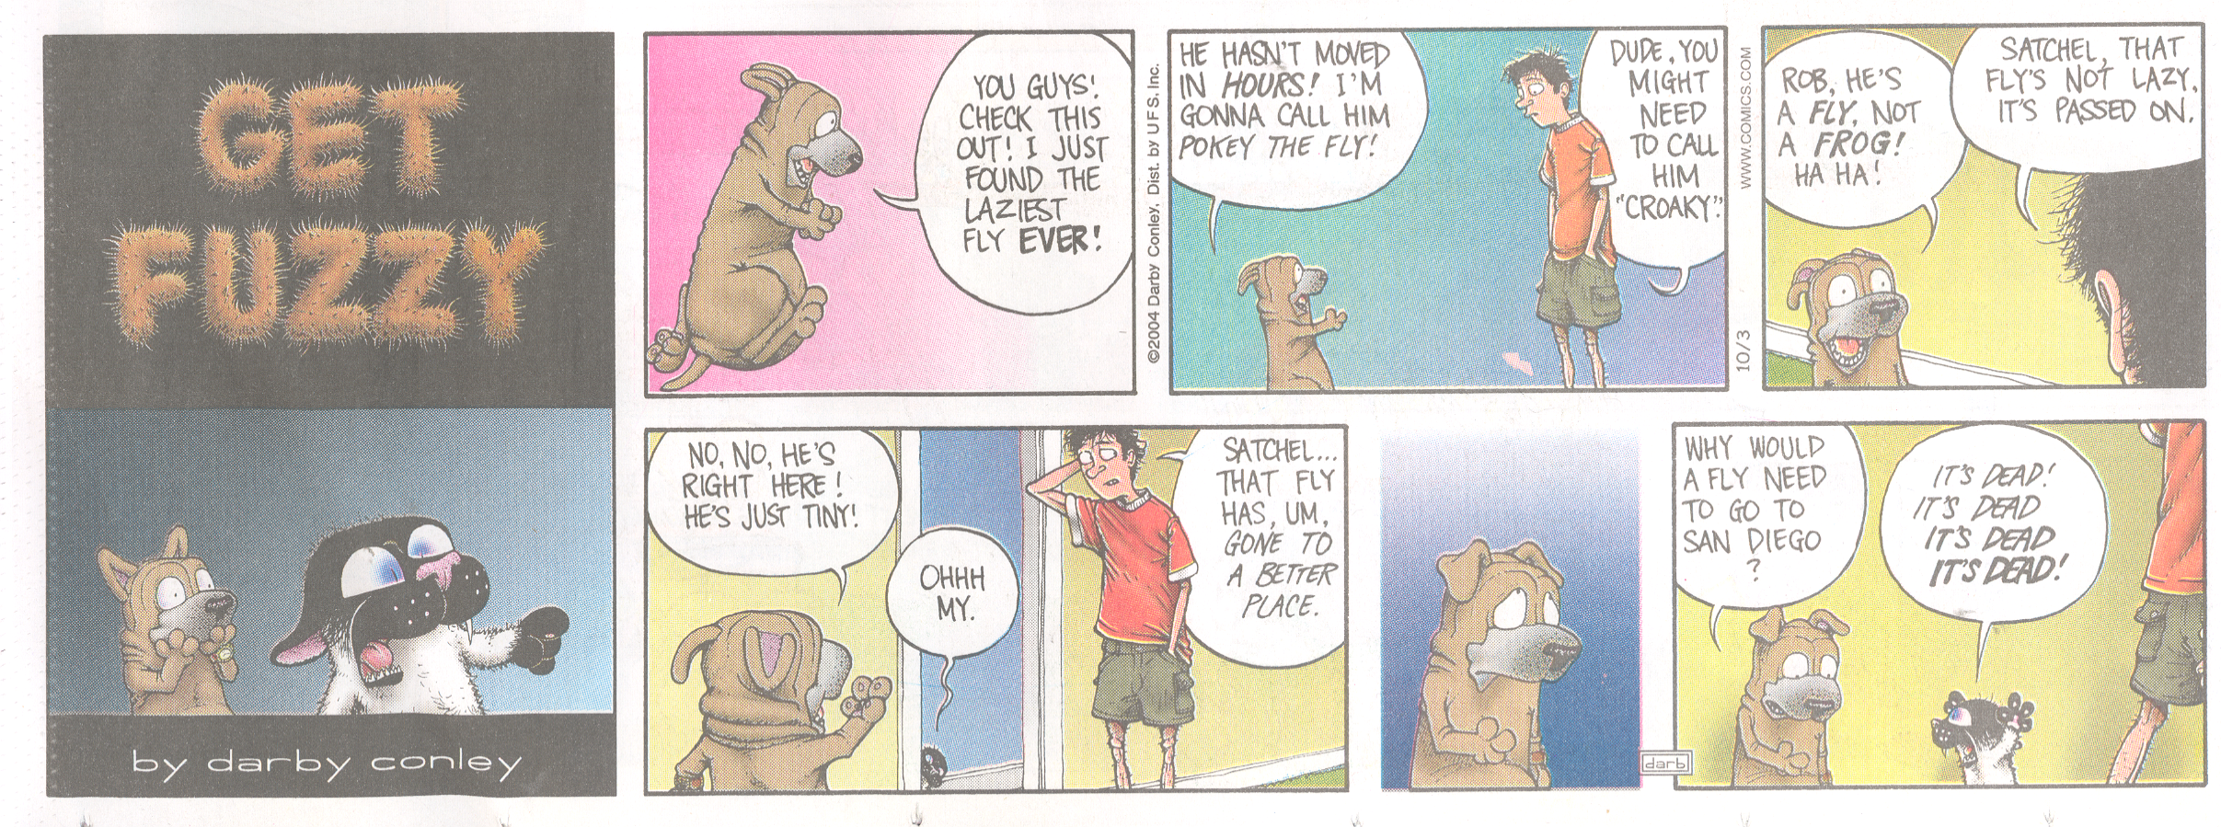
Avoid using the word “death”

Slide 11
Avoid providing accurate information

Slide 12
BUT is avoidance possible even in a culture of avoidance?
“No time in life can be guaranteed to be free from all encounters with death, loss, and grief.” (Work Group on Palliative Care for Children, 1999)
Children are exposed to death via radio, TV, film, video games, etc.
Mainstream American children: countervailing forces of avoidance and exposure

Slide 13
Our study of the socialization of death
Rosengren, Miller, Gutierrez, Chow, Schein, & Anderson (in press)
Site: “Centerville” = small city in Midwestern U.S.
Ethnographic methods: documents, participant-observation, interviews with teachers, clinicians
Parents (N = 71) of 3-6 year olds, most of European descent, college educated: questionnaires, interviews
Children (N = 101) of these parents: interviews
Children’s books: archive search, textual analysis

Slide 14
Some highlights of our findings
(Rosengren et al., in press, SRCD Monographs)
Cultural beliefs/practices at community level
  What were the perspectives of clinicians?
Cultural beliefs/practices at family level: Parents
  Parents’ reports of their children’s experiences of death?
  Parents’ beliefs/practices ?
Relevant cultural artifacts
  Do books for children deal with death? If so, how do they depict death?

Slide 15
Highlight #1: Centerville Clinicians

Slide 16
Interviews with Centerville clinicians
In-depth interviews with 4 clinicians (10+ years of experience) who regularly work with children who experienced traumatic loss
Qs about:
  Beliefs about young children’s understanding/coping with death
  Specific instances of young children who experienced death of close family member
  Advice to parents in such situations

Slide 17
Centerville clinicians’ perspectives
Adults need to help young children deal with death
Advice to parents: be open and honest with children about death
Very challenging for parents to support children while grieving themselves; parents vary
Grieving/healing takes time
Grieving children make sense of death in creative ways

Slide 18
Centerville clinicians: Challenges for parents
  Example 1: 3-year-old child’s mom died of illness. Dad was very supportive. Took her to mom’s grave. Talked to her as though mother were still with them. Child began to talk out loud to mom. Dad tried to inhibit his neg feelings as a way of protecting child, but led to issues of emotional restraint .
  Example 2: 3-year-old child’s uncle was murdered. Parents were too traumatized by the death to provide support for her. Did not explain what happened in a manner that she could understand. Told her that her uncle had been “killed.” But she didn’t know what “killed” meant. She acted out in preschool.

Slide 19
Centerville clinicians:
Children’s creative sense making
Example 1: C lost her mom in a car accident. “Mom is in heaven because God needed an angel…[her] body is just there [in the grave] but it’s not living…her spirit is out”
Example 2: C’s cousin died in a car accident. Told therapist, “[He’s] done with hell” (because he burned up in the accident) and so he is now in heaven.
**These examples influenced by Christian religion

Slide 20
Centerville clinicians:
Children’s creative sense making
Example 3: “My mom’s in heaven [but] I think my mom is getting tired…if you stood up in heaven all the time [in the clouds] wouldn’t you want to sit down sometimes? And if you sat down on that cloud, your feet would hang over the edge…I look every single day and I have never seen my mother’s feet.”
**C created a unique synthesis of religious beliefs and biological knowledge

Slide 21
Centerville clinicians:
Children’s creative sense making
Example 4: C asked her therapist if she thought her deceased mother would “grow back when it gets back to summer time?...she might come back as a flower.” C had witnessed her mom’s coffin being lowered into the ground. Using her knowledge that seeds planted in the ground emerge as plants, she reasoned analogically that her mom would grow back.
**Creative use of biological knowledge

Slide 22
Centerville clinicians and clinical literature
Both encourage parents to be open and honest with children
Both believe that avoidance of death is not helpful
Both believe that even young children are able to make sense of death in creative ways, given adult support and age-appropriate explanations

Slide 23
Highlight #2: Centerville Parents

Slide 24
Parents’ reports of their children’s experiences of death?
N = 71 parents, responses to questionnaire
Child experienced death of a relative 38%
Child experienced death of a pet 55%
Child experienced neither 28%
Child attended wake/funeral 39%

Slide 25
Parents’ reports of their beliefs/practices?
Questionnaires, also interviews with moms whose children had recently experienced a death
A dominant folk theory of SHIELDING children
  Most did not take children to funerals/wakes
  Most shielded children from death in TV, film
  -- Why? Children are too young to understand death or cope with strong feelings that death can evoke
  -- Parents had trouble coping; tried to protect children from their feelings

Slide 26
Parents’ reports of their beliefs/practices?
When they talked to their children about death:
Indirect
Avoidant
Vague
Example 1: C was very close to grandmother; when she died, parents did not tell him of her death.
Example 2: When C asked repeatedly , “What happens when you die?” M: “I don’t know.”

Slide 27
More examples of parents’ vague, avoidant talk
  Example 3: Responding to child’s Qs about pet mouse that had died:
  M: “the mouse went somewhere else, someplace happy”
  Example 4: family’s nanny died in a car accident,
  M: “she was sleeping and that we won’t be able to see her or talk to her because she won’t be able to come and play anymore”
  C: “[the nanny needed] a Snow White Kiss, you know because Snow White is sleeping and then they wake her up”

Slide 28
Individual variation among Centerville parents
Dominant folk theory of shielding or protecting children from death: aligns with macro cultural tendency to avoid death
BUT a minority of parents subscribed to a subordinate folk theory, similar to clinicians: don’t hide death from children, be open and forthright
Parents also varied in the extent to which they offered religious perspectives on death

Slide 29
Examples of open, forthright approach to death
Example 1: M took the death of a pet as an opportunity to expose C to realities of death. After family cat was hit by a car, she showed her children the blood on the road because, “I wanted it to be real. So they understood that when something got killed in that manner, there could be blood.”

Slide 30
Examples of open, forthright approach to death
Example 2: M prepared her children for the euthanization of the family dog.: “the vet was gonna give her a special medicine. And then the dog would fall asleep at first, and then they would give her another medicine and then her heart would stop beating. [The children] know that when your heart stops beating your body has died.” She expressed gratitude because this experience helped her children deal with the death of their grandfather.

Slide 31
Highlight #3: Children’s Literature

Slide 32
Does children’s literature deal with death?
Caldecott Winners
Children’s Favorite Books
Awarded annually to the most distinguished picture book for children
We examined winners from 1938-2004
Based on responses to parental questionnaire
TOTAL BOOKS = 198
  Only 6 had any mention of death
  Death never a central focus of the book

Slide 33
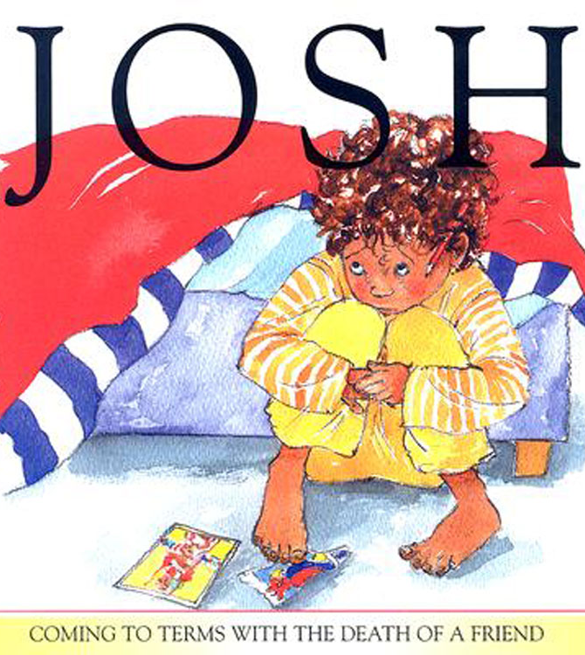
Analysis of children’s books about death
Designed for children who experienced a significant death
Examined 109 books from local libraries and book stories

Slide 34
Analysis of children’s books about death
90% stories, 10% educational
Most portrayed human deaths, 33% animals
Rich source of info about emotional reactions
View death from variety of perspectives: biological, religious, spiritual
Often mix biological,religious,spiritual

Slide 35
Educational books with information about emotions
Example 1: When Dinosaurs Die: A Guide to Understanding Death by Brown & Brown
Includes a chapter called, “Feelings about Death”
“When someone you care about dies, you may have all kinds of feelings” : difficulty sleeping, nightmares, missing the dead person, sadness, loneliness, loss of appetite, fear worry, stomach ache, etc.
Child encouraged to talk about feelings

Slide 36
Educational books with information about emotions
What’s heaven? By Maria Shriver
Mourners at a funeral are depicted as crying, hugging, being quiet, “Everyone has their own way.”
Features a child protagonist who is curious about her great grandmother’s death
Adults do not discourage her Qs, take them seriously
Religious interpretation of death: her soul is taken up to heaven by the angels

Slide 37
Conclusions
Cultural avoidance of death occurs in Centerville
  Apparent in parents’ dominant folk theory of shielding/protecting young children from death
  Apparent in children’s books, most of which avoid the topic
But also an alternative view (clinicians, some moms)
  Children need help in dealing with death and best help is open and honest explanation about what happened, in safe context that allows them to air their concerns

Slide 38
Conclusions
Children’s books about death can be used by parents to open conversation about death
  33% of the parents of children who had experienced the death of a relative or friend used books in this way
Clinicians endorse this practice
Young children are curious about death and are able to make sense of death in creative ways, if provided appropriate information and safe context

Slide 39
Conclusions
Many teachers, clinicians, and parents underestimate young children’s cognitive capacity to make sense of death
Our study of the Centerville children revealed that young children’s understanding of death is more advanced than previously thought. Even 3 year olds:
  Knew basic elements of the emotional script for death
  Showed understanding of the subconcepts of death

Slide 40
Implications and questions for the future
We hope to encourage reflection (especially in the U.S.) about the wisdom of avoiding death
We hope to encourage parents to think about how to handle death with young children
We hope to encourage study of how other cultures deal with death. How do they socialize young children with respect to death?

Slide 41
Preview of study in Mexico (Gutierrez, 2009)

Slide 42
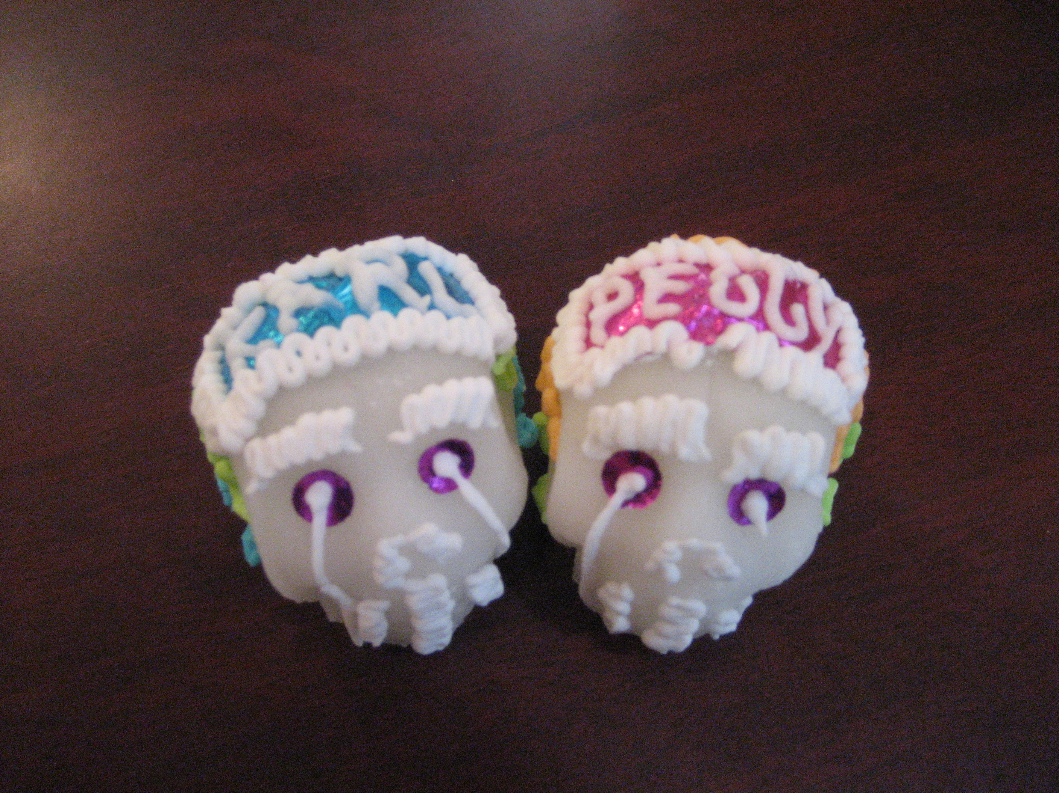
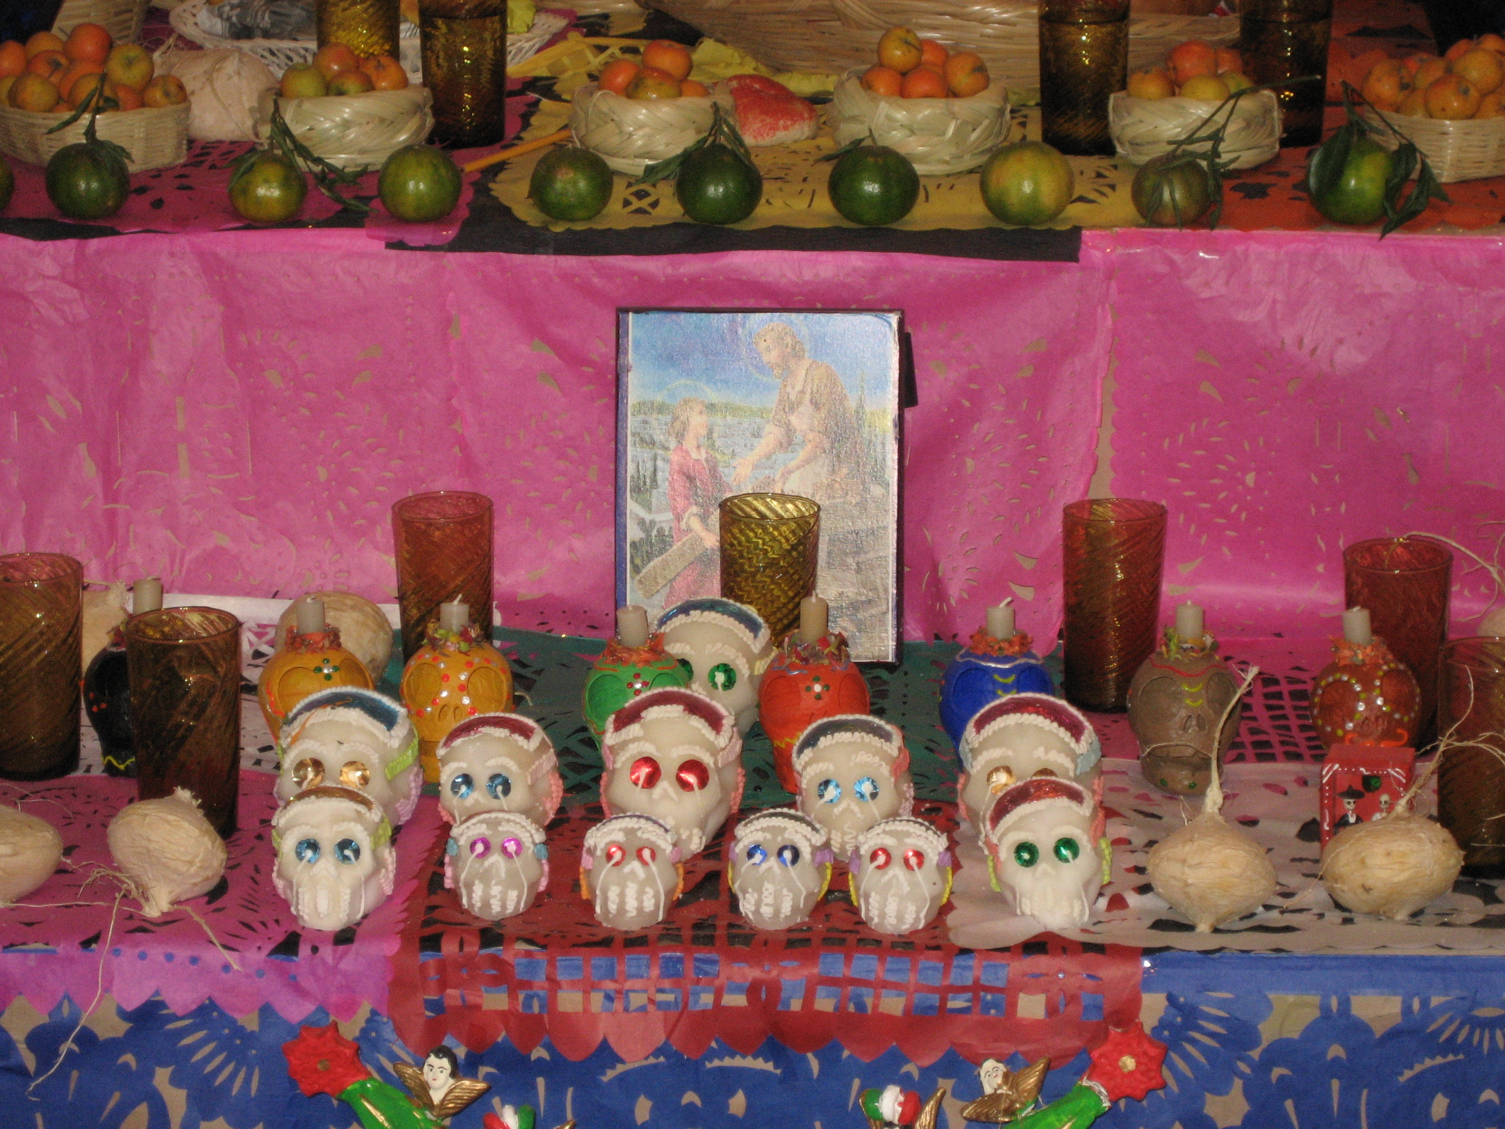
Death in Mexico
Dia de los Muertos (Day of the Dead)
  The word “death” is not pronounced in New York, in Paris, in London, because it burns the lips…..The Mexican, in contrast, is familiar with death, jokes about it, caresses it, sleeps with it, celebrates it; it is one of his favorite toys and his most steadfast love.
    - Octavio Paz, Nobel Prize Winner in Literature

Slide 43
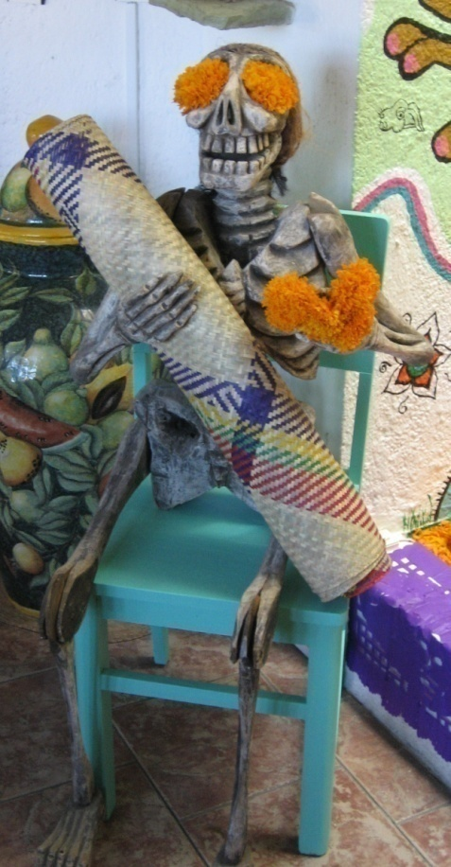
Death often called the national symbol of Mexico
Dia de los Muertos is a national Holiday in Mexico
Schools teach about the tradition

Slide 44
Parents’ talk to children about death
Centerville
Puebla
Indirect
Avoidant
Vague
Shield children from death
Direct
Straightforward
Factual
Help children embrace death

Slide 45
A Mexican parent
“We laugh about death. We are not afraid of it. When we are about to die, sometimes since we are ill, we will say that the "huesuda" (the bony one) is already coming for us. We start making thousands of jokes about it. Coming to the conclusion of a death is painful, but we know that it is the step to a better afterlife. As Mexicans we hug death, we accept it and at the same time we make fun of it.”

Slide 46
Another Mexican parent
“Death is so natural. It is a stage in our lives. We can't cover something that's unavoidable. Playing with our own lives is a painful risk; we don't know how much pain we can cause other people. It is something unavoidable.”

Slide 47
Importance of celebration of “dia de los muertos”
It serves as a way to remember, worship, and celebrate those that have died (74%)
It is a tradition that has been passed from generation to generation (68%)
It is the time of the year when the dead come to visit and the living do things to receive them (42%)

Slide 48
Parents’ Beliefs (Folk Theories)
Centerville (European-Amer)
Puebla (Mexico)
Children should be shielded from death
  In general
  In TV/movies
Children can’t cope with death because they lack:
  Emotional capacity
  Cognitive capacity
Children should be familiar with death
  It is inevitable
  It is part of life
Important to remember the dead
  This is comforting to children
Important to be conscious of abiding psychological and spiritual connection to the dead

Slide 49
Mexican children’s experiences of death
(Centerville)
Death of a relative 62% (38%)
Death of a pet 71% (55%)
Neither 11% (28%)
Attended funeral 59% (39%)
“Dia de los muertos” 89% ( 0%)

Slide 50
Thanks to:
Karl Rosengren
Isabel Guttierez
Stevie Schein
Phil Chow
Louise Greathouse Amador
Jill Wickery
Kate Olsen
Carol Diener
Kathy Anderson

