Slide 1
Varieties of Ethnographic Methods
Peggy J. Miller
Dept of Psychology, Dept of Communication
University of Illinois
at Urbana-Champaign

Slide 2
What is ethnography?
One type of qualitative inquiry
Other types:
Clinical case study
Textual analysis
Conversation analysis
Oriented to the study of culturally organized (shared) meanings

Slide 3
Outline
My personal history
History of ethnography
Characteristics of ethnography
Many versions of ethnography
Two examples of ethnographic studies
Socialization of death
Personal storytelling in Taipei & Chicago

Slide 4
Personal history: Why ethnography has been so important to me
The BIG problem: Socialization
All human children grow up to be cultural beings
Q: How does this happen?

Slide 5
Personal history: Why ethnography has been so important to me (cont)
No one becomes a member of CULTURE in general
Human beings become members of SPECIFIC cultures
Children born into pre-existing world of practices and traditions created by previous generations
Children use their growing interpretive skills to participate, to navigate, to make meanings

Slide 6
Personal history: Why ethnography has been so important to me (cont)
If culture lies at the heart of process of childhood socialization, then we need methods designed to address meaning
That’s what ethnographic methods do!

Slide 7
History of ethnography
Coined by anthropologists (late 19th c.) to describe study of “others”
Traveled to far-off locales to study others first-hand
Goal: to understand particular culture on its own terms, from perspective of people themselves
Malinowski: 2 hallmarks of ethnography
Long-term participant observation
Interviewing

Slide 8
What are ethnographers after?
Meanings:
Collective
Sapir: culture = form of collective lunacy
Explicit and implicit
Hymes: deepest meanings may not be talked about, so fully taken-for-granted
Coherent but not too coherent
Multiple, dynamic, ambiguous
Briggs: culture = bag of ingredients

Slide 9
Characteristics of Ethnography
Sustained and engaged
Microscopic and holistic
Flexible and self-corrective
Multiple cultural lenses

Slide 10
#1 Sustained & engaged
Takes time to learn the shared meanings of others
What is daily life like?
Everyday routines? Categories of persons?
Physical and institutional settings?
Language? Communicative norms?
Takes time to document
Fieldnotes
Informal talk, formal interviews
Collect documents
Audio and video recordings

Slide 11
#1 Sustained & engaged (cont)
Takes time to form relationships
Participant-observation
Involves fitting in, getting along

Slide 12
#1 Sustained & Engaged: Examples
Keith Basso
Western Apache, Wisdom sits in places (1996)
30 + years, informants taught, corrected, teased the ethnographer
Testified as an expert witness in land disputes
Jean Briggs
Inuit of Canada, Never in anger (1970), Inuit morality play (1998)
30 + years, informants shunned the ethnographer for violating norms
Helping to preserve indigenous language

Slide 13
#2 Microscopic & Holistic
Examine actions at the micro-level and interpret those micro-level patterns in light of larger contexts
E.g., Basso studied joking and linked to fraught history of W Apache relationships with white people
E.g., Briggs’ examined how adults teased young children and related to ideologies of childrearing
E.g., Miller et al. examined how families told stories with young children and related to larger currents of cultural meaning

Slide 14
#3 Flexible & Self-Corrective
Research Qs may have to get altered in the field
Can’t study shamans if no shamans
Can’t study young children learning to talk if a taboo against children talking to strangers
“Communicative blunders” result in changed procedures (Learning how to ask, C. Briggs, 1986)
Ethnographer not allowed to ask certain kinds of Qs because he is younger, less skilled than his informants
People don’t tell stories if ethnographer does not share

Slide 15
#3 Flexible & Self-Corrective (continued)
Participant may have her own agenda; ethnographer is wise to follow the participant
Mrs. Lin did not want to answer Heidi Fung’s Qs; she wanted to tell the ethnographer about her two marriages (Fung, 2003)
Mrs. Hudley would not be “interviewed” about her life; she wanted to tell her life story her way without Qs or interruptions (“Raise up a child” Haight & Miller, 2009)
Creating codes that are culturally valid

Slide 16
#4 Multiple Cultural Lenses
Ethnographers:
try to understand meanings from the perspective of participants
try NOT to mistake their OWN taken-for-granted cultural assumptions for those of participants
often develop a new awareness of their own culture
try to translate meanings of study participants so that other cultural groups can understand
SO, even when the ethnographer is studying a single group: more than one cultural lens

Slide 17
Many versions of ethnography
Ethnographic methods bear marks of disciplinary history/context
E.g. Social work: policy implications, making a difference for child welfare
Ethnographic methods = a craft or practice passed down through intellectual lineages

Slide 18
Many versions of ethnographic methods (continued)
Some privilege observations of everyday life
Some privilege interviews
Some pay very close attention to language
Some count
Some care greatly about how the account is written

Slide 19
Many versions of ethnographic methods (continued)
Some study a single cultural “case”
Some compare two or more “cases”
Some focus on the ethnographer’s own culture
Etc. etc.

Slide 20
Example #1
Study that combines ethnographic methods with quantitative methods (i.e., “mixed methods”) to investigate the socialization of death
(Rosengren, Miller, Gutierrez, Chow, Schein, & Anderson, in press, SRCD Monographs)
An example of studying one’s own culture

Slide 21
Socialization of Death
Site: “Centerville” = small city in Midwestern U.S.
Ethnographic study:
Participant observation of tragedy
Document search
Clinicians: interviews
Preschool teachers: focus groups
Parents: interviews
Study of children’s books: archive search, textual analysis
Study of parents (N = 71) most European descent, college educated: questionnaires
Study of children (3-6 year olds) (N = 101): standard protocols

Slide 22
A tragedy in Centerville
A highly educated parent in an upper middle-class family attacked the two children in the family, killing one and seriously injuring the other
Shock and loss in the community
How should the school (attended by the surviving youngster) handle this situation with 3-6 year olds?
Some parents: ignore, do not discuss
Some parents: use euphemisms, such as child was “sick” or “had an accident”
Why? Young children not able to understand or cope

Slide 23
A tragedy in Centerville (continued)
Surviving child recovered quickly
School decided:
Best for surviving child to return to supportive school environment
Best for all of the children: openness and honesty
Told factual information
Given the opportunity to ask questions
Given the opportunity to meet with clinicians
Some parents strenuously objected, withdrew their children from school
Children who remained: welcomed chance to talk, coped well

Slide 24
A tragedy in Centerville (continued)
This account based on:
Accounts of the event in local media
First-hand experience of a member of our research team, consulted by the preschool
In-depth interview with the director of the preschool
Dramatically illustrated:
Challenges in talking to children about death
Strong cultural current of AVOIDANCE of death, SHIELDING children from death

Slide 25
Conclusions of our study: Ex 1
Cultural avoidance of death in Centerville
Parents’ reactions to the tragedy
Parents’ dominant folk theory of shielding or protecting young from death (questionnaires, interviews)
Children’s books, most of which avoid the topic
But also an alternative view
School’s response to tragedy, clinicians, some moms
Children need help in dealing with death; best help is open & honest explanation in safe context that allows them to air their concerns

Slide 26
Conclusions: Ex 1 (continued)
Children’s books about death can be used by parents to open conversations
33% of parents of children who experienced the death of a relative of friend used books
Clinicians endorse this practice
Young children are curious about death and are able to make sense of death in creative ways if provided accurate information and safe context (clinicians’ reports, parents’ reports)

Slide 27
Conclusions Ex 1 (continued)
Many teachers and parents underestimate children’s cognitive capacity to make sense of death (teachers’ reports, parents’ reports)
Young children’s understanding of death is more advanced than previously thought. Even 3 year olds:
Knew basic elements of the emotional script for death (child protocols)
Understood sub-concepts of death (child protocols)

Slide 28
Conclusions Ex 1 (continued)
Ethnographic methods plus quantitative methods produced a fuller picture:
Multiple contexts (home, school, books)
Cross-cutting cultural currents (avoidance of death)
Children’s understanding/coping
Within-culture variation
Raises Qs:
Is it wise to avoid death?
What are the best ways to handle death with young children?
How do other cultures deal with death?

Slide 29
Example #2
Ethnographic study of personal storytelling as a medium of socialization in Taipei & Chicago
(Miller, Fung, Lin, Chen, & Boldt, 2012, SRCD Monographs)
An example that
Makes an explicit comparison of two cultural “cases”
Pays close attention to language: “discourse-centered ethnography

Slide 30
Childhood socialization happens through everyday talk
Interdisciplinary problem
Two influential interdisciplinary fields:
Language socialization
Dev cultural psychology
Key: Discursive practices

Slide 31
Socialization via Narrative Practices
Power of narrative:
Social practice
Form of representation

Slide 32
Why Stories of Personal Experience?
Universal
Variable
Early

Slide 33
Example of early co-narrated story: Yoyo (2,6) & Grandmother
G: Oh, right. This morning when Mom was spanking you, what did you say? You said, ‘Don’t hit me!’ Right?
Y: Hmn (nods)
G: Then, what did I tell you to say?
Y: ‘I won’t push the screen down.’
G: Oh, right. So, what would you say to Mom?

Slide 34
Yoyo & Grandmother (continued)
Y: I would say to Mom, ‘Don’t have the screen pushed down.’ (Yoyo moves closer and speaks in a very low tone into G’s ear)
G: Oh, you would talk to Mom, saying, ‘Mama, I won’t push the screen down.’
Y: Hmn.
G: So, Mom wouldn’t hit you.

Slide 35
Yoyo & Grandmother (continued)
Y: Hmn.
G: Right? Hmn. If you asked Mom, ‘You don’t hit me,’ Mom would have hit you, right?
Y: Hmn. (nods)
G: So, you would directly say to Mom in this way, ‘Mom, I won’t push the screen down.’ Then how would Mom have reacted?
(continues through 14 more turns)

Slide 36
Big Question:
How is personal storytelling practiced with young children?
Does personal storytelling recur?
How does personal storytelling change over time?

Slide 37
Why is Recurrence So Important?
Routine practices have specific cognitive consequences (Vygotsky)
Also affective, social, identity consequences
Early practices become habitualized (Bourdieu)
Routine practices entail variation (e.g. Bauman & Briggs, 1990; J. Briggs, 1998; Kulick & Schieffelin, 2004)
Notes:
37
Sapir, Vygotsky, Bourdieu
Language socialization, cultural psychology
Key to socialization: everyday talk/discursive practices

Slide 38

Taipei & “Longwood,” Chicago
Chicago
Taipei
Notes:
http://www.kagyuoffice.org/dharmacenters.html

Slide 39
Studying PS in Taipei and Longwood (Chicago)
Participants: MC, urban, two-parent families
Ethnographic fieldwork
Researchers: Eur-Am & Taiwanese
Home observations of everyday talk
Longitudinal: 2,6; 3,0; 3,6; 4,0
Transcription of stories, coding of stories
Interviews with mothers

Slide 40
How was PS practiced in Taipei & Longwood at 2,6; 3,0; 3,6; 4,0?
Q1: routinely?
Q2: culturally salient interpretive frameworks?
Q3: children’s participant roles?
Q4: changes in participation?
(Miller, Fung, Lin, Chen, & Boldt, 2012 SRCD Monographs)

Slide 41





Taipei, Taiwan

Slide 42
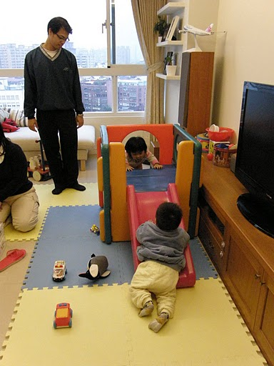
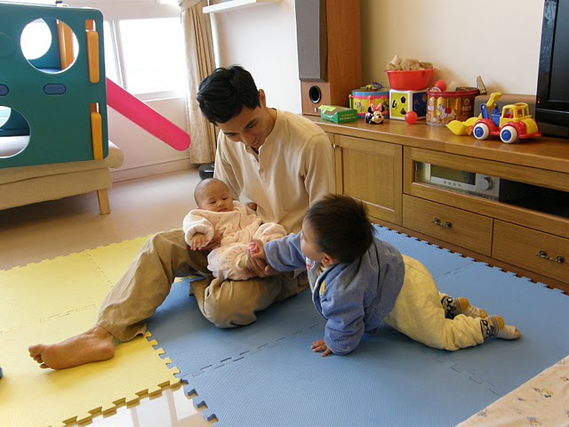
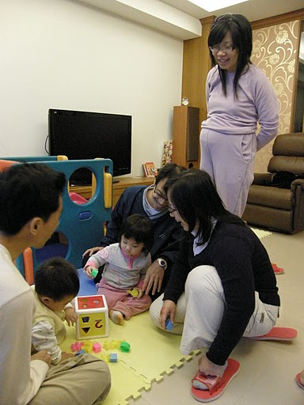
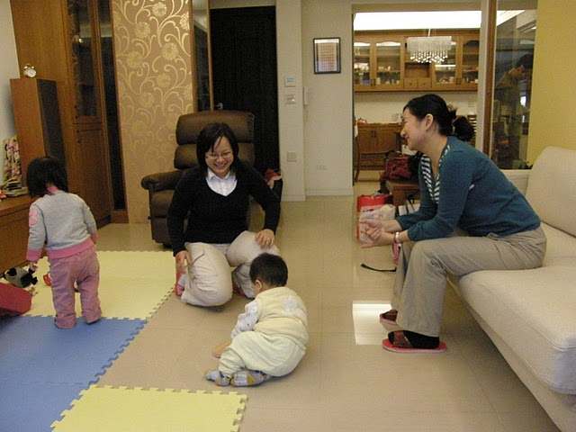
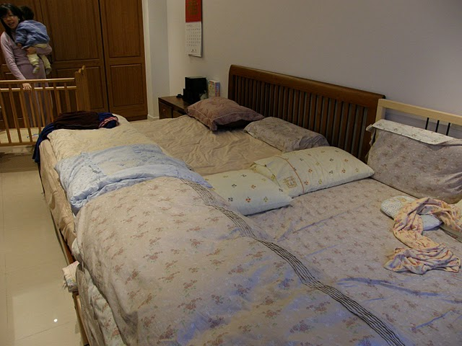
Taipei, Taiwan

Slide 43

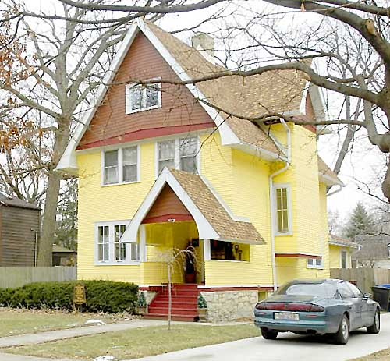


Longwood, Chicago

Slide 44

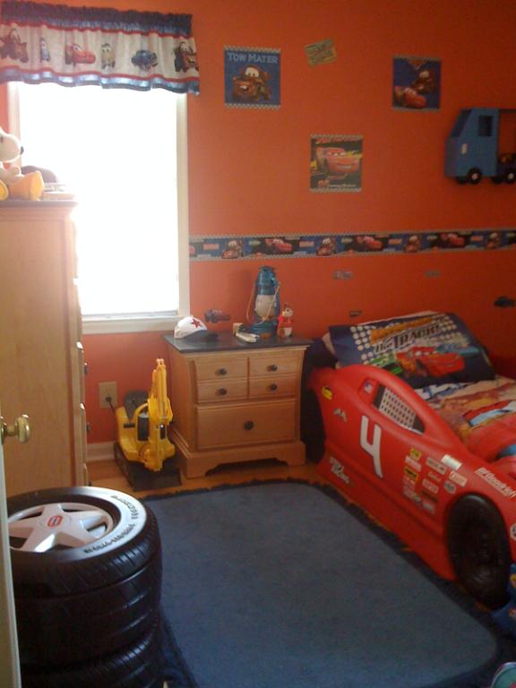
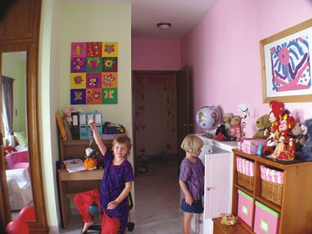

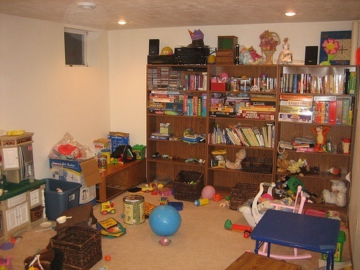
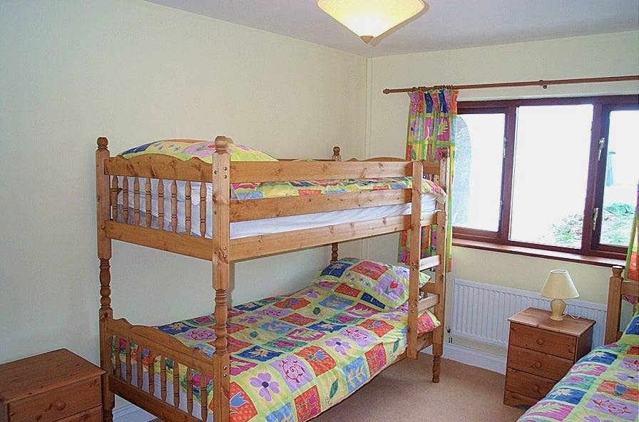
Longwood, Chicago

Slide 45
Question 1
Was personal storytelling practiced routinely?
(Miller, Fung, & Mintz, 1996; Miller et al., 1997; Miller et al., 2012)

Slide 46
Personal Storytelling: Rates/Hour

Slide 47
Question 2 Did PS carry salient interpretive frameworks?
Taipei: Didactic
Longwood: Child-affirming
Notes:
Didactic in Taipei, affirming in Longwood
Content, function, structure

Slide 48
Didactic: Narrated Transgressions

Slide 49
Examples of Transgression Stories
Yoyo (2,6) pushed the screen down and objected when mom punished him
Meimei (3,0) opened a gift, messed up the cake
Didi (4,0) got lost at the night market

Slide 50
Child-Affirming Framework
Omit the negative: child-favorability bias
Example: Tommy (2,6) started to misbehave but caught himself, he was “real good” and was rewarded
Accentuate the positive
Child-positive: LW + inflation
Humor: LW > T
Preference: LW > T, LW = inherently positive

Slide 51
Example of co-narrated story that is child-affirming: Amy (4,0) & Mother
A:Once there was a fire….that’s what the policeman told me at day camp.
M: What did he say?
A: He (policeman) tell me to go to the fire department, um the police, to, if you crash, you have to call the policeman.
M: If you cra, what did he say? If you crash?

Slide 52
Amy & Mother (continued)
A: If you crash, you have to call the policeman, right?
M: OK, and when do you call the fire department?
A: When the fire is, is out.
M: Oh, when there’s a fire?
A: Yeah.

Slide 53
Amy and Mother (continued)
M: So, he would get the fire out, I see. And when would you call an ambulance?
A: When someone is hurt.
M: “Exactamundo! (does high five) You are the smartest 4 year old! And there’s the smartest 6 year old and the smartest 2 year old!”

Slide 54
Conclusions Ex 2: How was personal storytelling practiced?
Q1: routinely? Taipei Longwood
Q2: frameworks? Didactic Child-Affirming
Complex pattern of similarities & differences
Formed alternate socializing pathways
Remarkably stable at each level of analysis from 2,6; 3,0; 3,6; 4,0

Slide 55
Conclusions Ex 2: How was personal storytelling practiced? (continued)
These socializing pathways could not have been discovered without examining discursive practices in everyday life
Their meanings could not have been discerned without micro-analysis
These meanings connect to larger currents of meaning at the macro level
Didactic → Confucian echoes
Child-Affirming → Self-esteem echoes

Slide 56
General Conclusions
Ethnographic methods ideally suited to study meaning in context; meaning lies at the heart of childhood socialization
Can be used to study other cultures (in keeping with long tradition)
Can be used to study one’s own culture
Either way: multiple cultural lenses involved

Slide 57
General Conclusions
Ethnographic methods are diverse:
Many ways to observe, participate, ask, listen
Some versions highlight talk; especially useful in revealing PROCESS of socialization
Many innovative ways to combine ethnographic and quantitative methods

Slide 58
Thanks to:
Karl Rosengren, Isabel Gutierrez, Philip Chow, Stevie Schein, Kathy Anderson
Heidi Fung, Shumin Lin, Eva Chen, Ben Boldt, Megan Olivarez

