Slide 1
Narrative in Children’s Lives
Peggy J. Miller
Department of Psychology
University of Illinois at Urbana-Champaign

Slide 2
Outline
Multiplicity of stories
Stories of personal experience
III. Socialization via stories
IV. Story attachments

Slide 3
What is narrative?
A powerful, universal tool of meaning making
Temporal ordering: A happened and then B and then C
Evaluation: Why these events matter

Slide 4
I. Multiplicity of narrative genres
Children everywhere encounter many types or genres of narrative

Slide 5

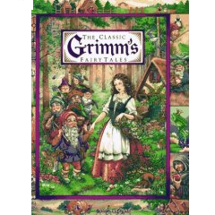

Slide 6
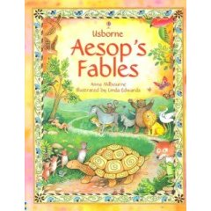

Slide 7

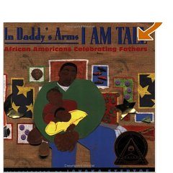




Slide 8



Slide 9


Slide 10



Slide 11


Slide 12
Genres of Narrative
Fairy tales
Fables
Children’s literature
Religious texts
Stories of personal experience
Family stories
Made-up stories
Traditional stories specific to the group
TV stories
Stories from movies
Computer-mediated stories

Slide 13
II. Stories of personal experience

Slide 14
Why Stories of Personal Experience?
Crop up again and again
Universal
Variable
Combine easily with other genres
Emerge early in development

Slide 15
Adult story of personal experience
Oral, told in conversation
1st-person: narrator invokes past event from own experience
Temporally ordered
“What happened next?”
Evaluated: has a point
“Why should I care?”
Notes:
Sapir, Vygotsky, Bourdieu
Language socialization, cultural psychology
Key to socialization: everyday talk/discursive practices

Slide 16
Example of a Story of Personal Experience
So one day we went down to the beach. It was just me and her, Johnnie wasn’t there…so the lifeguard comes over, and he gets ahold of my arms and he’s looking at me, and…. I say, “My little girl’s not here, she’s in the water! She’s in the water!” and he says, “Check the bathroom. We’ll go in the water, you go check the bathroom.” So I’m running. The whole time I’m running, I’m thinking, “Please God! Please let her be in the bathroom. I’m not going to be able to handle this if she’s in the water.” And I get up there and what do I see? These two little feet swinging by the toilet (uses her index finger to enact the swinging movement of Tara’s feet)…. Well, I busted in the door…here she is, she’s on the toilet! …I whip her up, I’m like, “Oh my God!” and I’m hugging her, “Don’t you ever come to the bathroom without telling me!” I’m crying my eyes out….She sees I’m so upset and then she looks at me and says, “Mom, I’m not finished pooping yet. Put me down.”

Slide 17
Structural Elements
Orientation as to time, place, person
“Trouble” or complicating action
Evaluation of what happened
Resolution
Possibly a coda
(Labov & Waletzky, 1967)
Notes:
17
Sapir, Vygotsky, Bourdieu
Language socialization, cultural psychology
Key to socialization: everyday talk/discursive practices

Slide 18
Structural elements exemplified
Orientation as to time, place, person
One day, the beach, narrator & daughter
“Trouble” or complicating action
Can’t find her daughter
Evaluation of what happened
Terrified that daughter has drowned
Resolution
Finds daughter in the bathroom
Possibly a coda
“Don’t you ever come to the bathroom without telling me!”

Slide 19
Early stories of personal experience
First genre to emerge developmentally
Told in interaction, child as co-narrator

Slide 20
A tiny narrator: Amy (19 mo.)
Mom: She pulled a little sneaky the other day, went out the back door and fell down and busted her back all up…Didn’t you? Went out there and fell.
Amy: (nods)
Mom: Mm. (nods) Say, ‘yes.’
Amy: Me big fall down. (lifts up dress)
Mom: You fell down, yeah. (smiles). You hit your back.
Amy: (lifts up dress again)

Slide 21
Early stories of personal experience
First genre to emerge developmentally
Told in interaction
Invokes small departures from the ordinary
Involves sound effects and nonverbal enactments

Slide 22
Another example: Tara (32 mo)
(Tara has been playing with her doll, pretending to feed her, says, “her choke”)
T: “Other day, other day…I tell Richard. Um Richard . (raises right arm, lets it fall) Richard down at work (puts fingers around eyes as if pressed against a window)He’s on the bus…”

Slide 23
Tara example (continued)
T: He’s on the bus. Get. (walks forward with rocky gait) Walkin.
(makes horrible face, mouth wide open, tongue out) Aach! Aach!
M: Who does that?
T: uh, Richard (looking at M(
M: He does? Why does he do that?
T: Because him choked. (raises arms)

Slide 24
Tara example (continued)
M: He got sick? Do you know why? D’you know why he choked? Cause he smoked cigarettes (in confiding, hushed tone, nodding solemnly)
T: (walks toward M) He smoked a cigarettes (quietly). You can’t smoke. (Shakes head) (Opens mouth, sticks out tongue, gestures toward her brother)

Slide 25
Tara example (continued)
T: Can’t eat beer. (gazes at M)
M: You can’t eat bear, no.
Brother: Not even wine. Not even wine.
M: Nope.

Slide 26
Structural elements: Tara (32 mo)
Tara: “Other day, other day…I tell Richard, um Richard down at work…He’s on the bus… [Orientation]
Tara: Get. Walking. [Complicating action]
Tara: ‘Aach! Aach!’ [Evaluation]
Mom: He got sick? You know why? [Eval]
Tara: You can’t smoke. Can’t eat beer. [Coda]
Tara’s brother: Not even wine. [Coda]

Slide 27
A related interesting fact
Profoundly deaf children, who are linguistically isolated, are able to create gestured narratives
(Van Deusen Phillips, Goldin-Meadow, & Miller, 2001)

Slide 28
Rapid development of stories of personal experience
Structural components
Dev of specific linguistic systems
e.g., tense marking (e.g., “Riley chewed up the raccoon!”)
E.g., evaluative devices (e.g., “I cried ‘waah!’ like that.”)
More sophisticated depictions of “landscape of consciousness”
Range of time frames (e.g, hypothetical, future)

Slide 29
Stories of personal experience are building blocks of life stories
Life story = oral story of one’s life over the long term
The events that have made me who I am
Emerges in adolescence
(Linde, 1989)

Slide 30
Stories of personal experience as building blocks of life stories
Extended reportability
Milestones
Relevant over long time periods
Selection among events
Events and meanings are not fixed

Slide 31
III. Socialization through Narrative

Slide 32
Socialization =
Process by which shared ways of being and acting in the world are passed on to children
Interactive: parents as guides, models, children as active meaning makers
Variation across cultures in shared beliefs and values

Slide 33
Narrative as medium/tool of socialization
Sociocultural theory (Vygotsky)
Participation in ROUTINE social activities
Socialization is mediated by TALK, everyday communicative practices
Especially narrative

Slide 34
Narrative as medium/tool of socialization
Power of narrative:
Form of representation
Social practice
(Bruner, 1990)

Slide 36
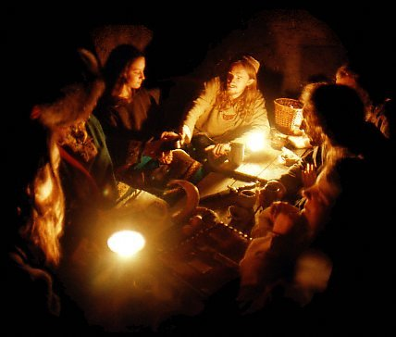
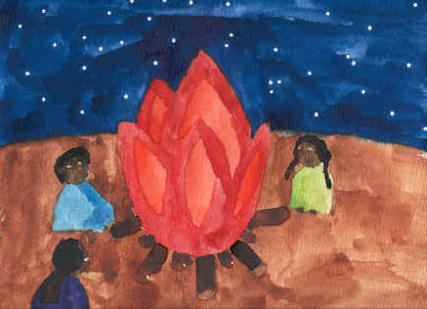
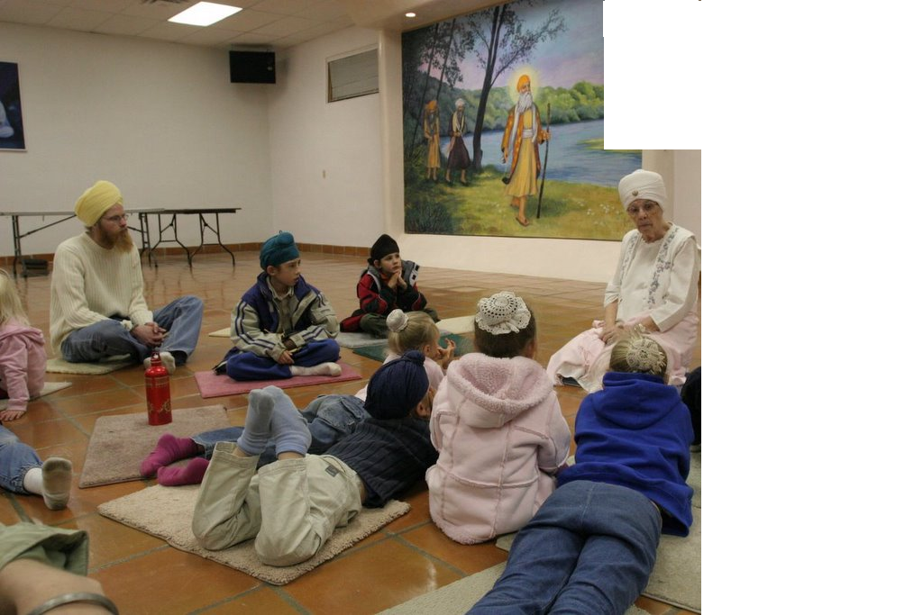
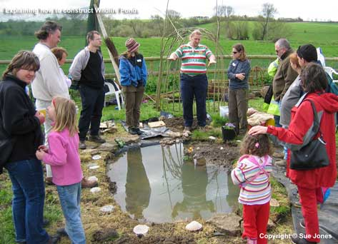

Slide 37
Stories of personal experience as medium of early socialization
Based on observations in homes and communities
Young children
ROUTINE: different ethnic, cultural, social class groups in the U.S.
(e.g., Heath, 1983; Miller, Cho, & Bracey, 2005; Ochs & Capps, 2001; Sperry & Sperry 2000)

Slide 38
Personal storytelling varies across groups
Appreciation of personal storytelling
Dimensions that define the genre
How children participate
**This variability exists from the beginning & conveys different values

Slide 39
Personal storytelling varies across groups
Appreciation of personal storytelling
Very frequently, avidly, and competently practiced in American working-class communities

Slide 40
Personal storytelling varies across groups
Dimensions that define the genre
Literal/fictional
Self-aggrandizing/self-denigrating
Humorous/serious
Didactic/non-didactic
Etc.
How young children participate

Slide 41
An example
Of personal storytelling as a routine but culturally differentiated medium of socialization
Taipei and Chicago (“Longwood”)
(Miller, Fung, & Mintz, 1996; Miller et al., 1997; Miller, Fung, Lin, Chen, & Boldt, 2012)

Slide 42

Taipei & “Longwood,” Chicago
Chicago
Taipei
Notes:
http://www.kagyuoffice.org/dharmacenters.html

Slide 43
How was PS practiced in Taipei & Longwood at 2,6; 3,0; 3,6; 4,0?
Q1: routinely?
Q2: culturally salient interpretive frameworks?
Q3: children’s participant roles?
Q4: changes in participation?
(Miller, Fung, Lin, Chen, & Boldt,2012 SRCD Monographs)

Slide 44





Taipei, Taiwan

Slide 45
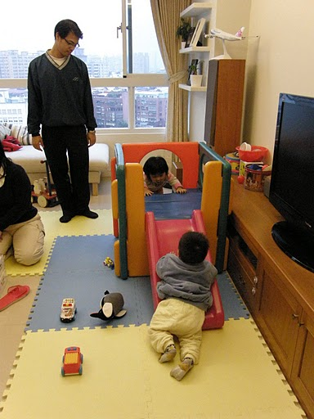
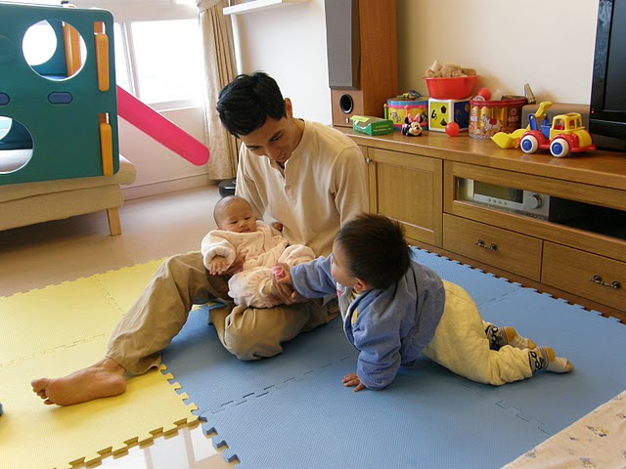
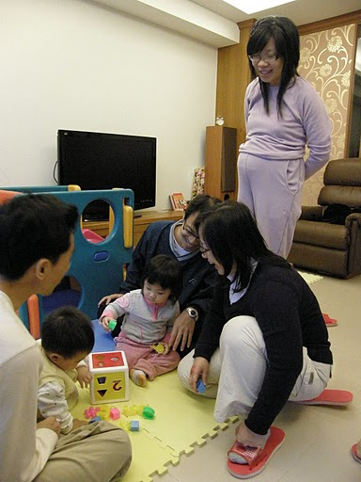
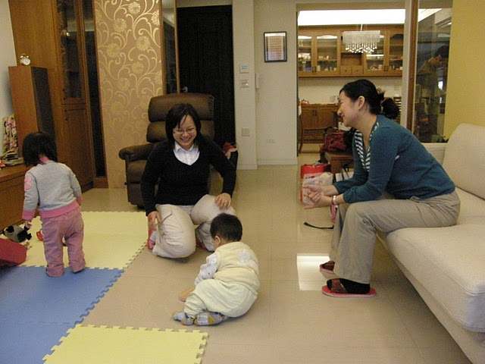
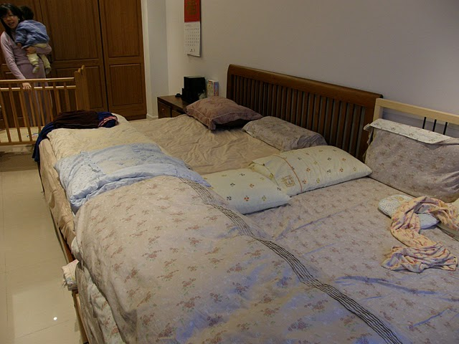
Taipei, Taiwan

Slide 46

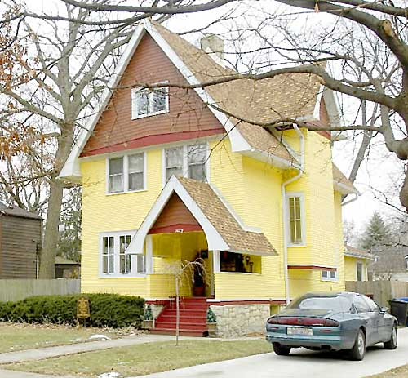


Longwood, Chicago

Slide 47

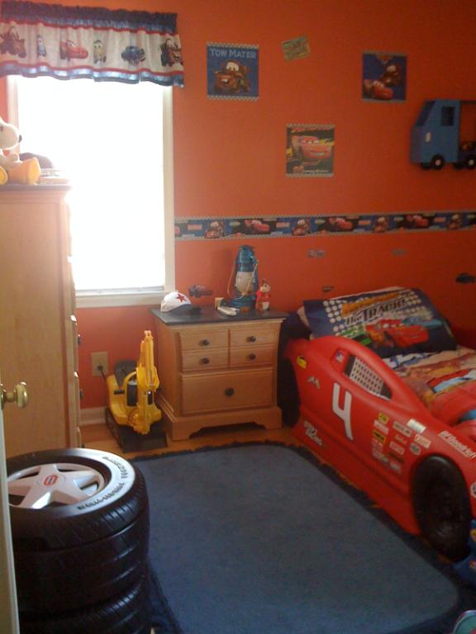
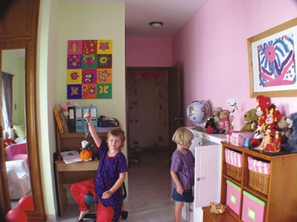

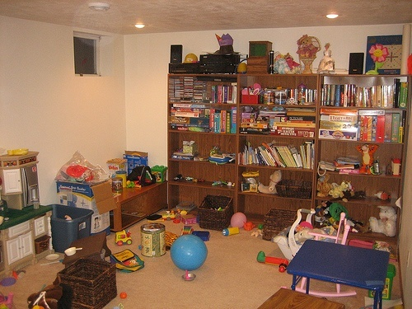
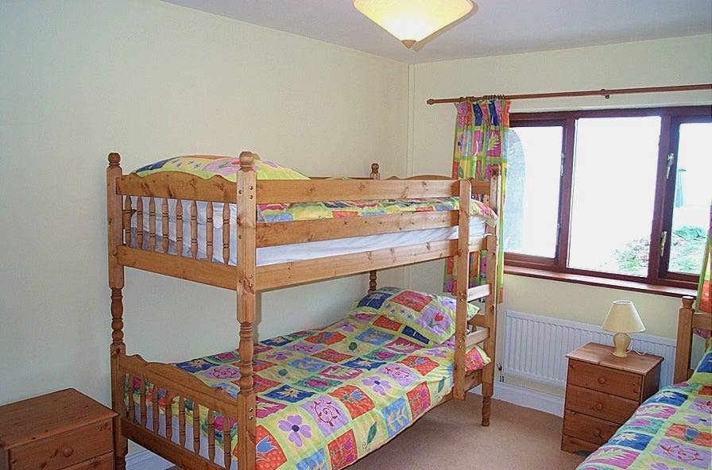
Longwood, Chicago

Slide 48
Question 1
Was personal storytelling practiced routinely?
YES

Slide 49
PS: Rates/Hour

Slide 50
Question 2 Did PS carry salient interpretive frameworks?
Taipei: Didactic
Longwood: Child-affirming
Notes:
Didactic in Taipei, affirming in Longwood
Content, function, structure

Slide 51
Didactic: Narrated Transgressions

Slide 52
Examples of Transgression Stories
Yoyo (2,6) pushed the screen down and objected when mom punished him
Meimei (3,0) opened a gift, messed up the cake
Didi (4,0) got lost at the night market

Slide 53
Child-Affirming Framework
Omit the negative: child-favorability bias
Example: Tommy (2,6) started to misbehave but caught himself, he was “real good” and was rewarded
Accentuate the positive
Child-positive: LW + inflation

Slide 54
Example: Child-Positive + Inflation (Amy 4,0)
Amy: “Once there was a fire….that’s what the policeman told me at day camp.”
Mom: series of tutorial Qs; Amy displays
Mom: “Exactamundo! (does high five) You are the smartest 4 year old! And there’s the smartest 6 year old and the smartest 2 year old!”

Slide 55
Question 3
What kinds of participant roles did the children enact?
Notes:
How is personal storytelling practiced?
How do parents and YOUNG CHILDREN participate?
How does their participation change over time?

Slide 56
Children’s Participant Roles
Co-narrator role
Bystander role
BOTH routinely available
BUT Taipei privileged bystander, Longwood privileged co-narrator

Slide 57
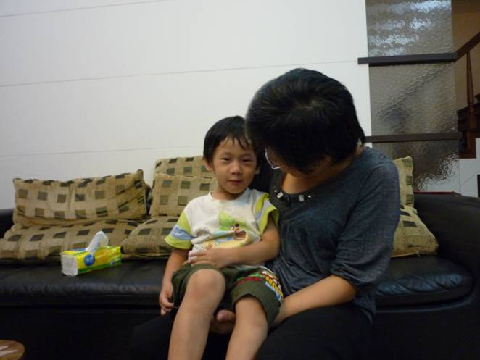
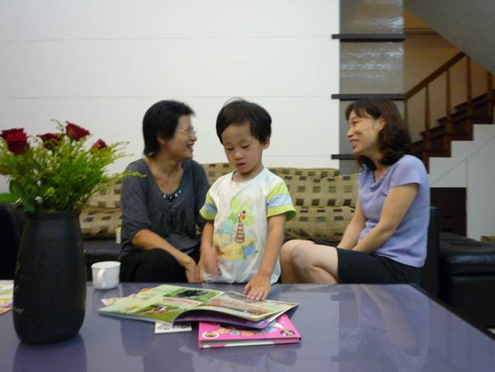
Children’s Participation in Taipei
Co-Narrator
Bystander
41%
59%

Slide 58
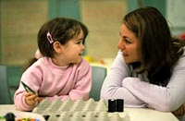

Children’s Participation in Longwood
Co-Narrator
Bystander
57%
43%

Slide 59
Question 4
How did their participation change over time?
Notes:
How is personal storytelling practiced?
How do parents and YOUNG CHILDREN participate?
How does their participation change over time?

Slide 60
Bystander: Listening

Slide 61
Co-Narrator: Authorship

Slide 62
Examples of children creatively co-narrating
“Why didn’t you reason with me nicely?” (Angu, 4,0)

Slide 63
Examples of children creatively co-narrating
“Why didn’t you reason with me nicely?” (Angu, 4,0)
“Why do you always say I do wonderful things?” (Patrick, 4,0)

Slide 64
Conclusions: How was PS practiced?
Q1: routinely? Taipei Longwood
Q2: frameworks? Didactic Child-Affirming
Q3: participant roles? Bystander Co-narrator
Q4: changes? Yes Yes
Complex pattern of similarities & differences
Formed alternate socializing pathways
Remarkably stable at each level of analysis from 2,6; 3,0; 3,6; 4,0
Recurring juxtapositions of frameworks & roles

Slide 65
Conclusions: Stories of personal experience as medium of socialization
Routinely practiced with young children in many (not all) places
Culturally differentiated from the beginning
Children come to operate in terms of culture-specific values, interpretive frameworks, ways of participating

Slide 66
IV. Story attachments
What is a story attachment? A strong and sustained emotional involvement with a particular story
Adults, children
Teachers, clinicians, writers, authors of children’s literature take for granted BUT few studies
(e.g., Miller et al., 1993; Paley, 1997; Wolf & Heath, 1992; Tatar, 2009)

Slide 67
A study of young children’s story attachments (Alexander, Miller & Hengst, 2001)
32 mothers of young children (2-5 year olds), European-American, college educated
Mothers were interviewed at home
Five of these mothers kept diaries

Slide 68
A study of young children’s story attachments: Example
Interviewer: “Has your child ever had a special story, one that he or she was very, very interested in or attached to?”
Mother of a 2 year old: “It’s called The Napping House. She’s been wanting this book every night, sometimes during the daytime too. She keeps requesting it. Now I think she can almost recite the story. She’s real intense about it. If I skip a word, she gets really mad.”

Slide 69
Another example of a story attachment
Mother of a 3 year old: “His first major attachment to any story was ‘Chitty Chitty Bang Bang.’ That was his first BIG attachment. We went through I would say a good solid six months of everyday watching that movie…At one point he would finish watching it and say, ‘Could I watch it again?’ He would scream, ‘Again!’ when the movie ended.”

Slide 70
Basic description
Mothers reported 2-8 attachments per child, mean of 5
Attachments lasted from 3 weeks to 4 years, mean of 1 year, 10 months
Described the attachment as intense or obsessive
“you couldn’t avoid it”
“wanted to watch it 24 hours a day”
“it got out of hand”

Slide 71
Basic description (continued)
Type of story to which children were attached:
33% written story
32% video story
27% story of personal experience
8% made-up story
These proportions mirrored reported family practices

Slide 72
How children expressed their attachments
Requested story 100%
Listened/looked intently 100%
Expressed feelings 94%
Asked questions 91%
Discussed/talked about 88%
Memorized story 88%
Pretended/acted out the story 75%
Retold the story 69%
Slept with book/video 53%
Carried book/video about 38%
Dreamt about 16%

Slide 73
Mothers’ views about why the child was attached to the story
Child liked the character or was similar to the character
Parallel between child’s experience and character’s experience
Fear of dark
Birth of new sibling
Story helps child to handle emotional concerns

Slide 74
Example of a mother’s explanation
“I think she identifies with characters in [the book] cause, especially with this book, it’s like her own personal experience. Well, it has a cat and a dog, that she can relate to because we have a cat and a dog like the ones in the book. And it has a granny and she has two grandmothers and she has visited them both every summer. We have pictures of our parents around the house and she sees them and talks to them regularly on

Slide 75
Mother’s explanation (continued)
(continues) the phone…So for some short period of time, she can sort of create a little world and a safe feeling through the book. It’s reliable when you’re upset or when you want some attention from mommy and daddy, ‘let’s read Napping House.’”

Slide 76
Mothers’ reactions
Majority said that they encouraged most attachments,
especially with the youngest children
especially to written stories
Some mothers eventually got frustrated or bored at prospect of reading, telling, or hearing the story yet again

Slide 77
Diary study
Five mothers kept diary records of their child’s story attachments
They documented 3 ways in which children used their special stories to manage emotions:
Watched/listened to story to savor or re-visit an enjoyable experience (e.g., sang & danced every time he watched his favorite video)
Watched/listened to story as a way to console self when upset
Story itself evoked fear; fear subsided over repeated viewings/listenings

Slide 78
Example of fear subsiding
When Jeffrey first saw the “Friend Like Me” video, he was afraid of the genie
One the second viewing, he showed less fear and increasing pleasure at sight of the genie
Third viewing: “Mommy, I not scared of when the genie comes now. I am big boy!”

Slide 79
Another example of fear subsiding
Isabelle’s mother wrote 12 entries over 16 days
When Isabelle first viewed “The Rescuers” video, there were 6 segments to which she responded by hiding in the corner
In the 4th viewing, Isabelle no longer hid but put her hands over her ears for three segments
In the 6th viewing, Isabelle neither hid not put her hands over her ears but said that she was afraid and warned her mother about an upcoming scary part
In later viewings, Isabelle watched intently and occasionally commented on the formerly scary parts

Slide 80
Conclusions re. story attachments
Begin very early in life: cognitive prerequisites modest, minimal ability to understand the story
Embedded in cultural practices
Ready access to books, videos, oral stories
Children granted choice
Parents support and encourage
Engagement with stories and story characters extends into other spheres of life (e.g., pretend play)
Helps children manage emotions

Slide 81
Overall conclusions: Stories in children’s lives
Narrative is both universal and culturally variable
Children come into the world with a predisposition for narrative (Bruner, 1990)
This inclination allows them to quickly grasp and use the narrative resources bequeathed to them
Narrative takes root and burgeons in the normative sociocultural practices of telling, interpreting, listening
Those practices include exposure to a multiplicity of stories

Slide 82
Conclusions (continued)
Those normative sociocultural practices vary within and across cultures:
Repertoire of story types or genres available
What counts as a reportable event
How actions are interpreted
The ways in which children are allowed or encouraged to participate
Children are active participants from the beginning
Orient to/listen to stories
Contribute verbally
Initiate stories
Become attached to some stories rather than others

