Slide 1
Pretend Play
Peggy Miller
Department of Psychology
University of Illinois at Urbana-Champaign

Slide 2

Pretend Play
What is pretend play?
  And why is it interesting?
Development of pretend play
Imaginary companions
Pretend play as coping
Cultural variation

Slide 3
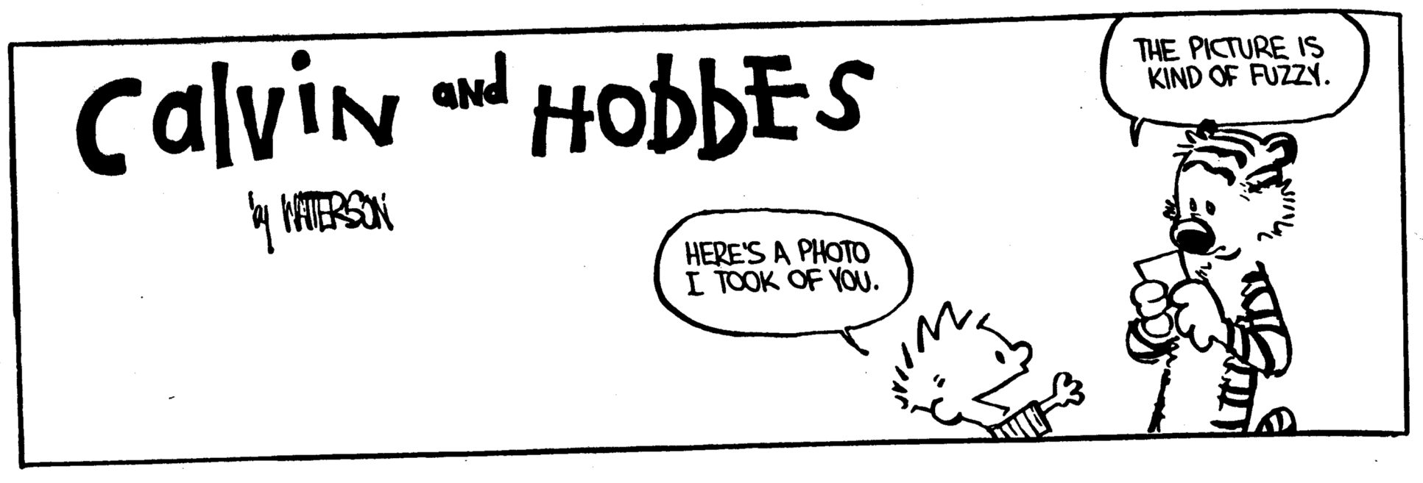

Slide 4
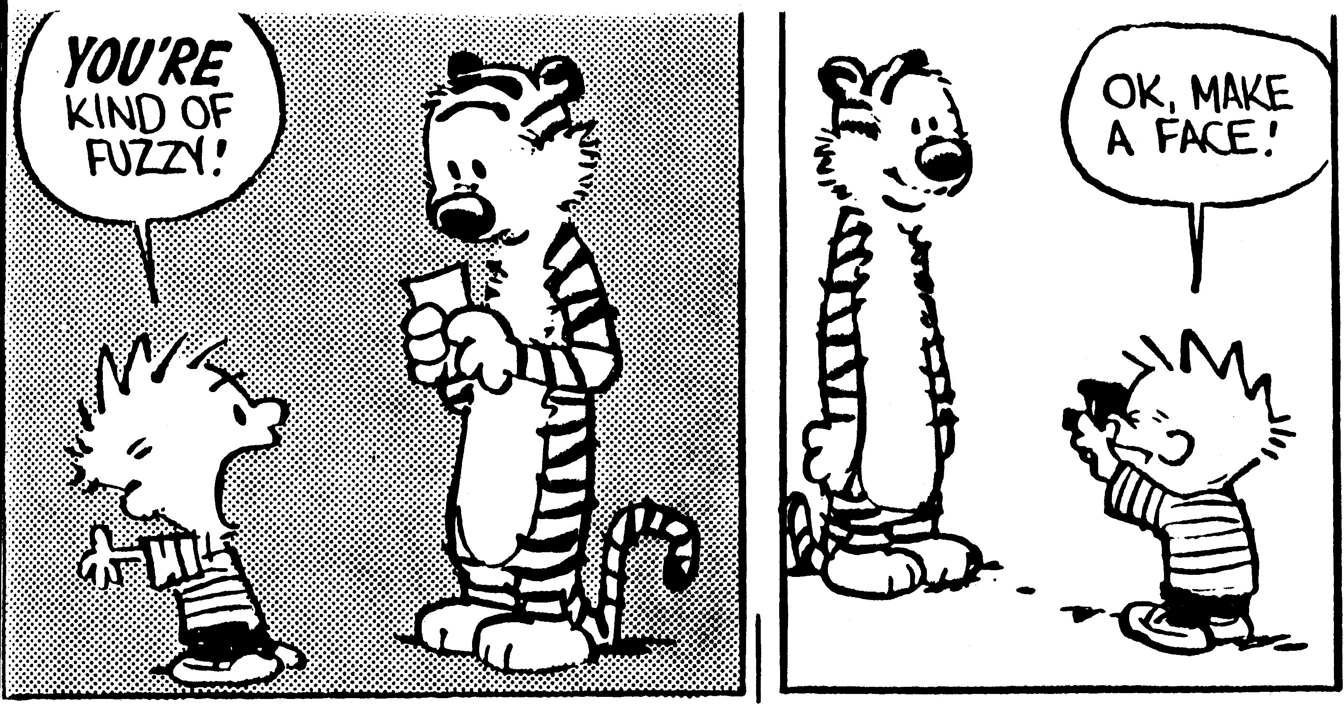

Slide 5
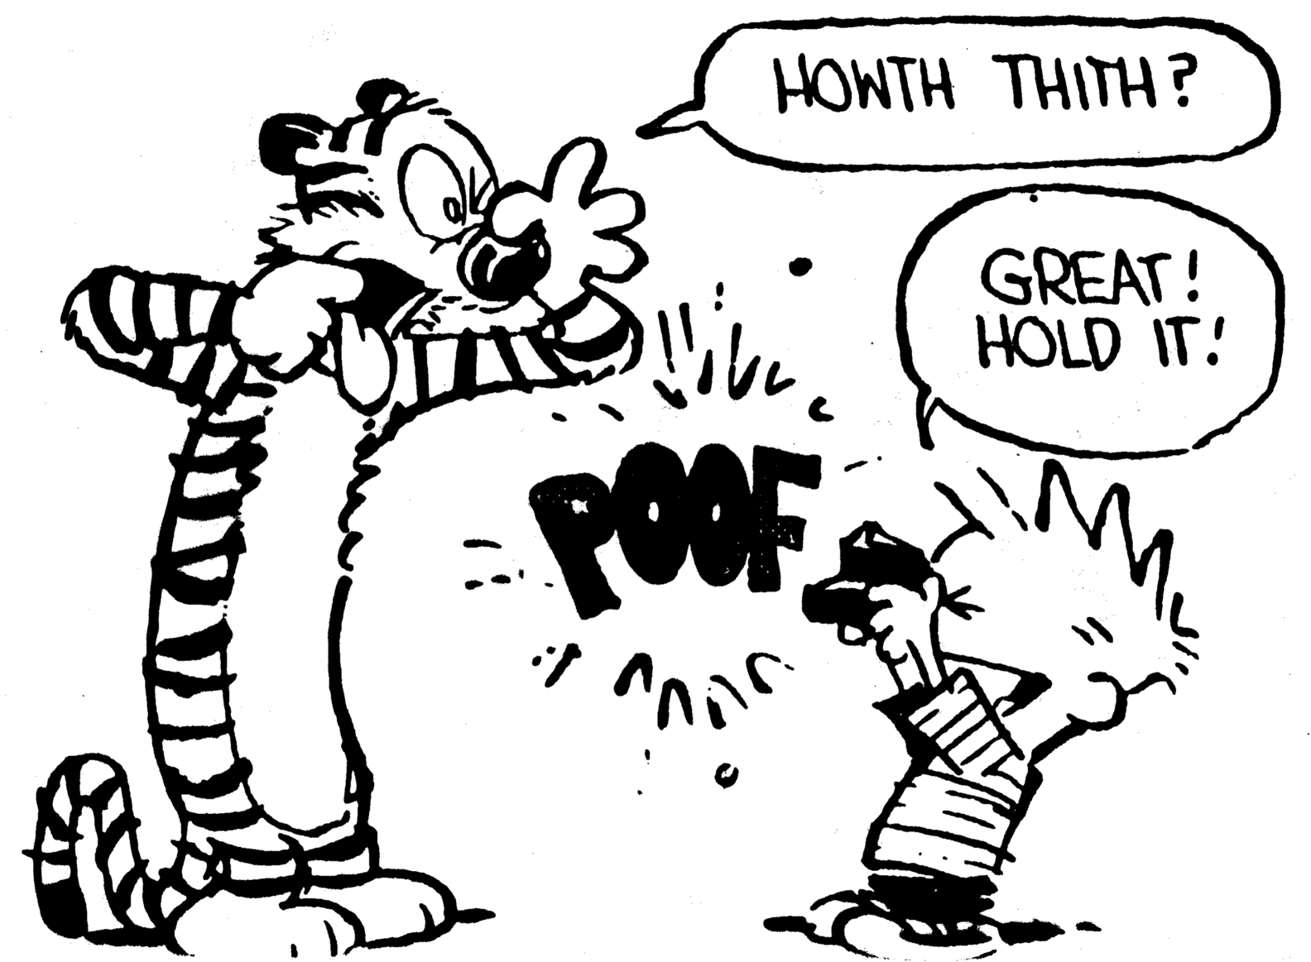

Slide 6
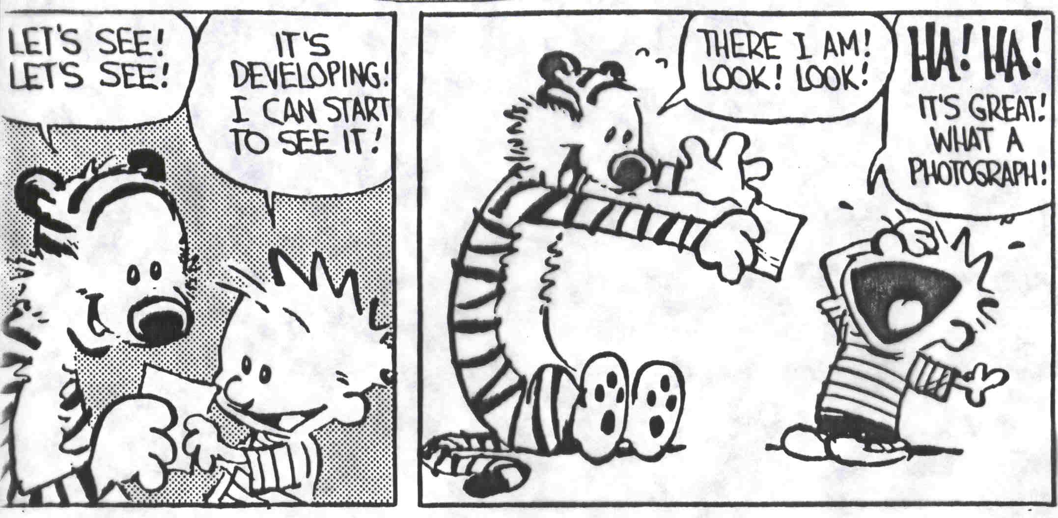

Slide 7
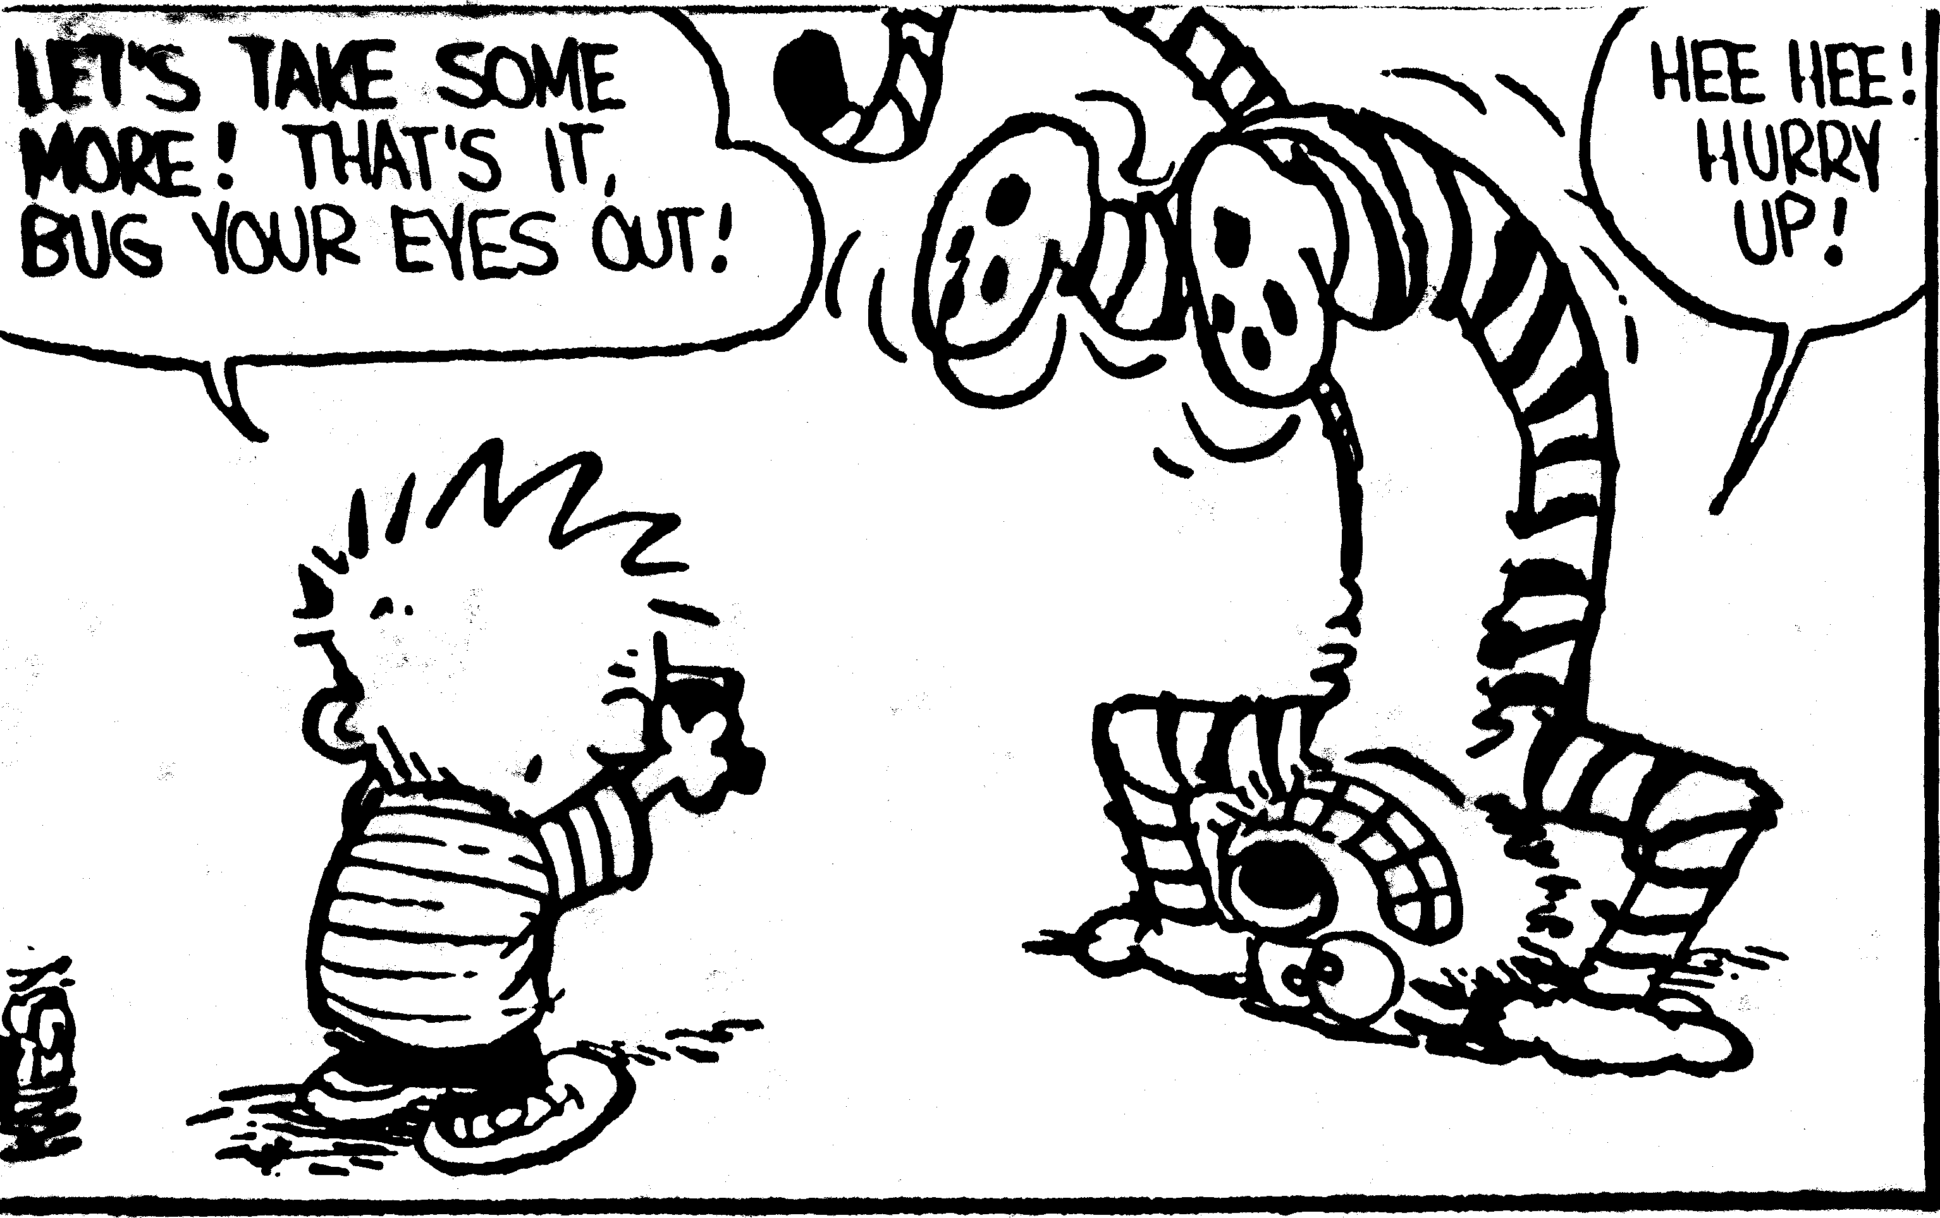

Slide 8
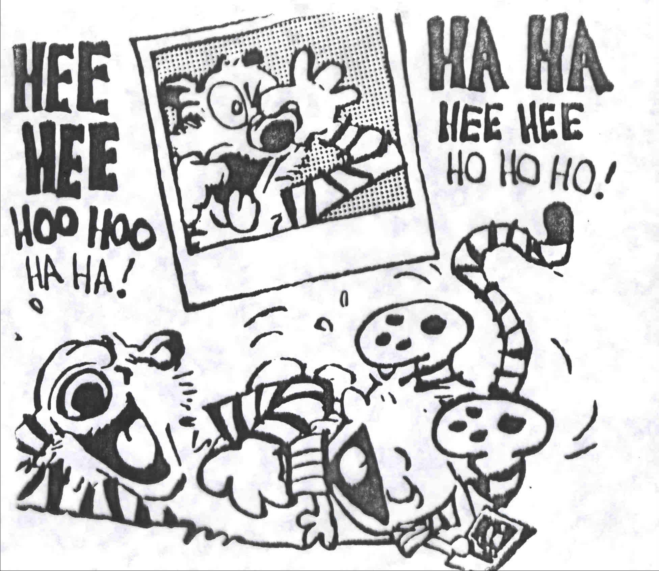

Slide 9
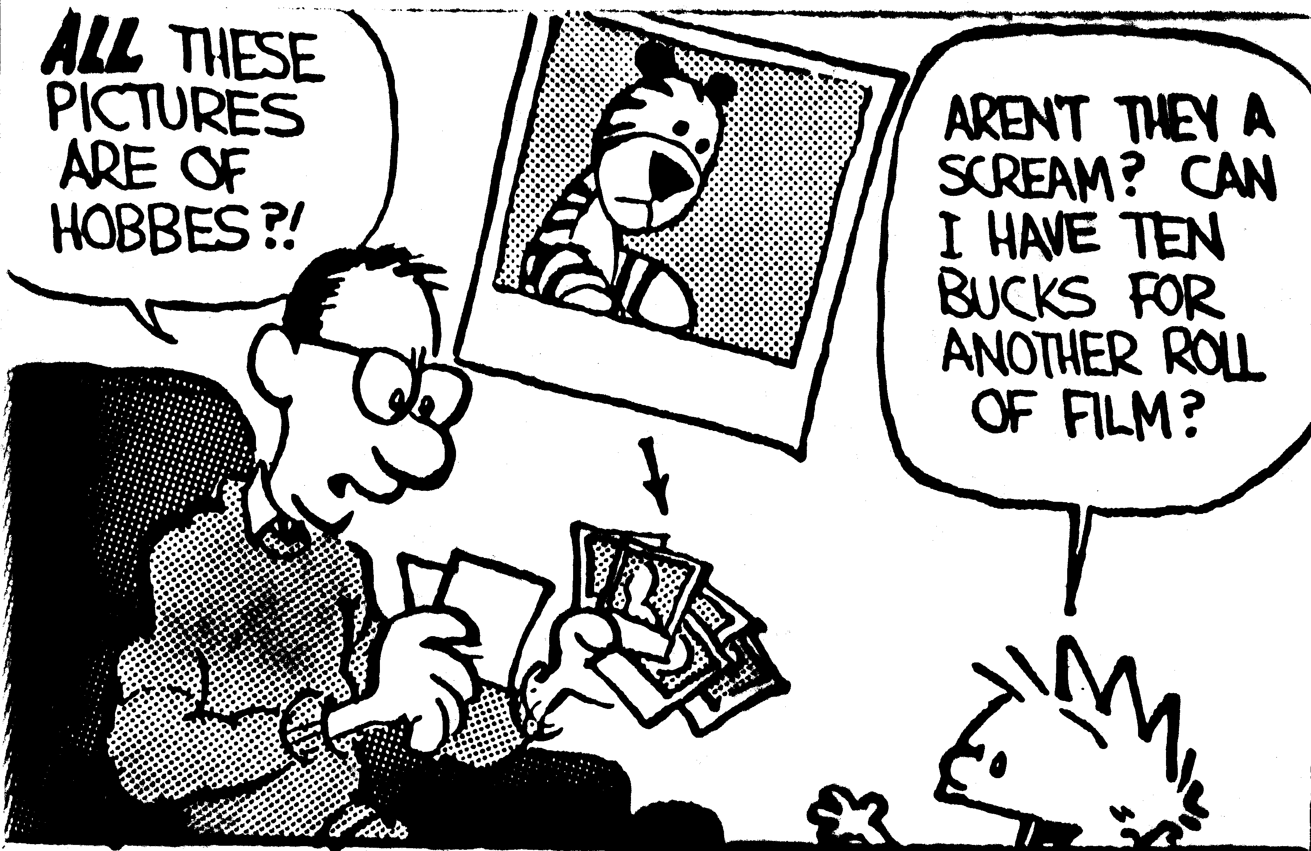

Slide 10
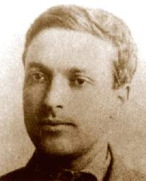
Why play is interesting developmentally
Associated with children
Children have an affinity
Window into child’s perspective
Social/affective/cognitive/ cultural
Classic theories
  Freud
  Piaget
  Vygotsky
Lev Semyonovich Vygotsky
(1896-1934)

Slide 11
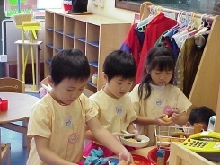
Properties of pretend play
Voluntary
Intrinsically motivating
Actively engaging
Nonliteral orientation
“as if”

Slide 12
Pretend Play
What is pretend play?
  And why is it interesting?
Development of pretend play
Imaginary companions
Pretend play as coping
Cultural variation

Slide 13
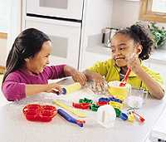
Development of pretend play
Appears around 1 year
Increases, then
Peaks ~ 3-5 years
  Pretend role play
  Imaginary companion
Developmental fate

Slide 14
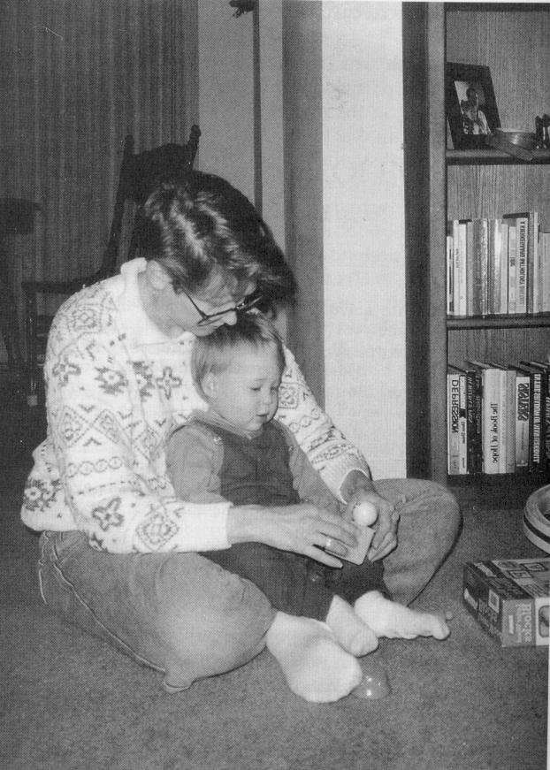
Development of pretend play: origins
Earliest pretend play
  Brief, fleeting
  Ordinary behavior out of context

Slide 15
Development of pretend play: 1-3 years
Becomes more frequent
Becomes more complex
  Child enacts multiple actions, ordered sequences
  Child animates objects
  Child substitutes one object for another

Slide 16
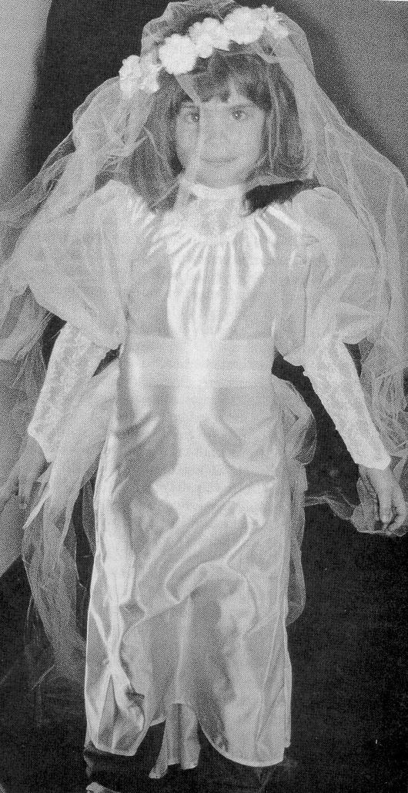
Development of pretend play: peak
Pretend role play = transformation of: actions, objects, and IDENTITIES
Reciprocal identities
e.g., bride/groom, Superhero/bad guy, doctor/patient, engine/caboose

Slide 17
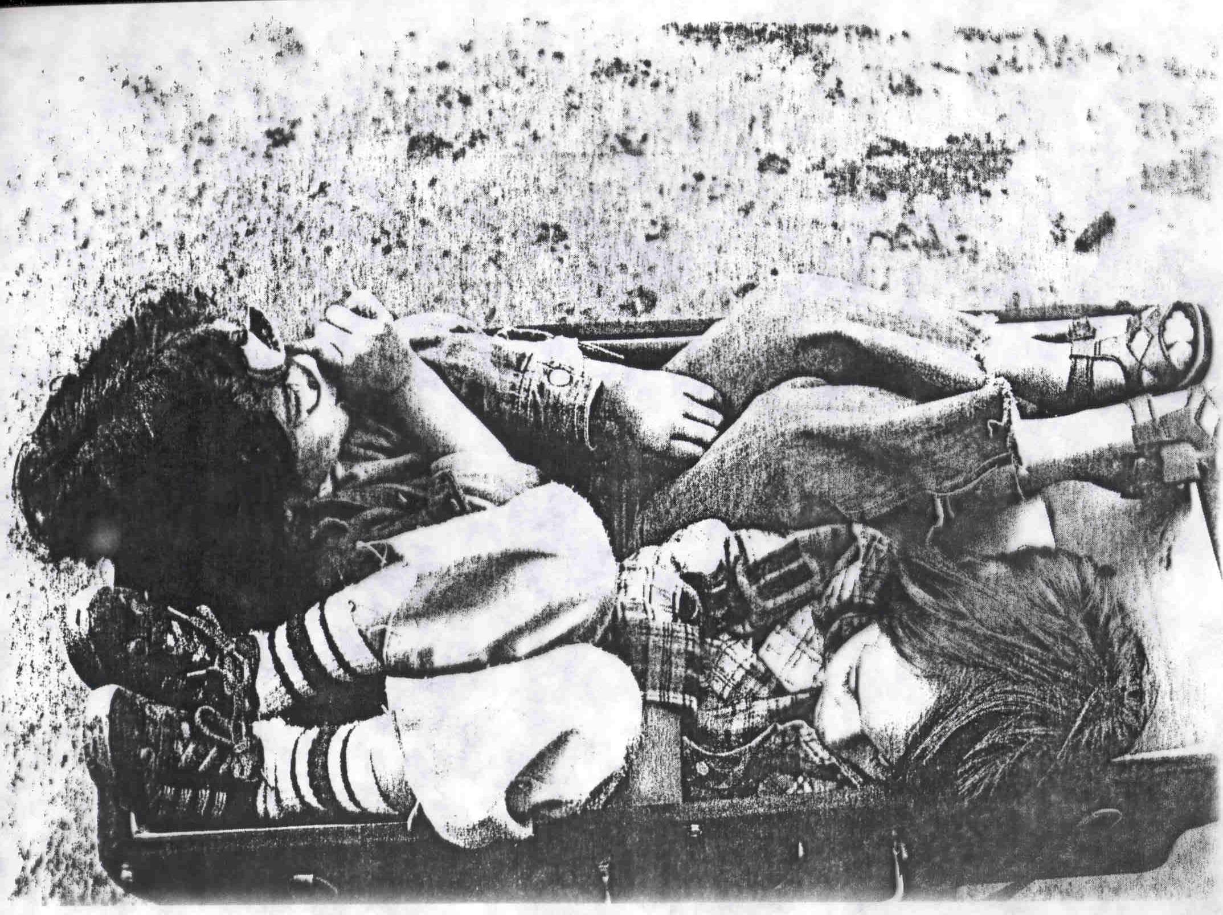
Transformed Identities

Slide 18
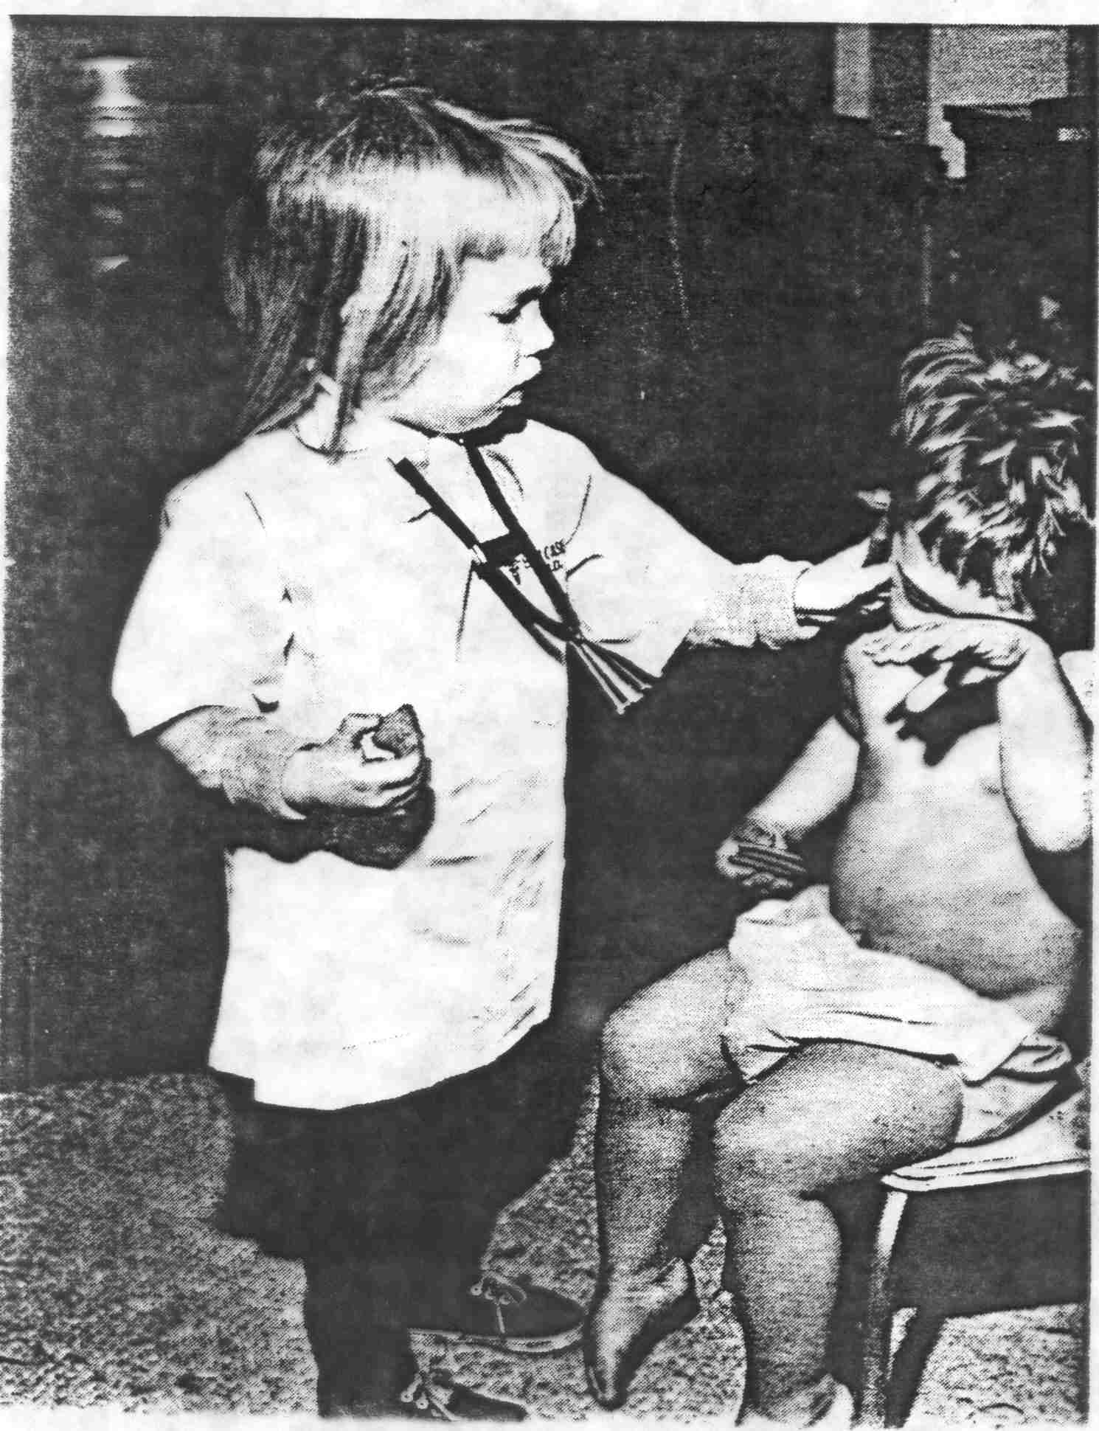
Transformed Identities

Slide 19
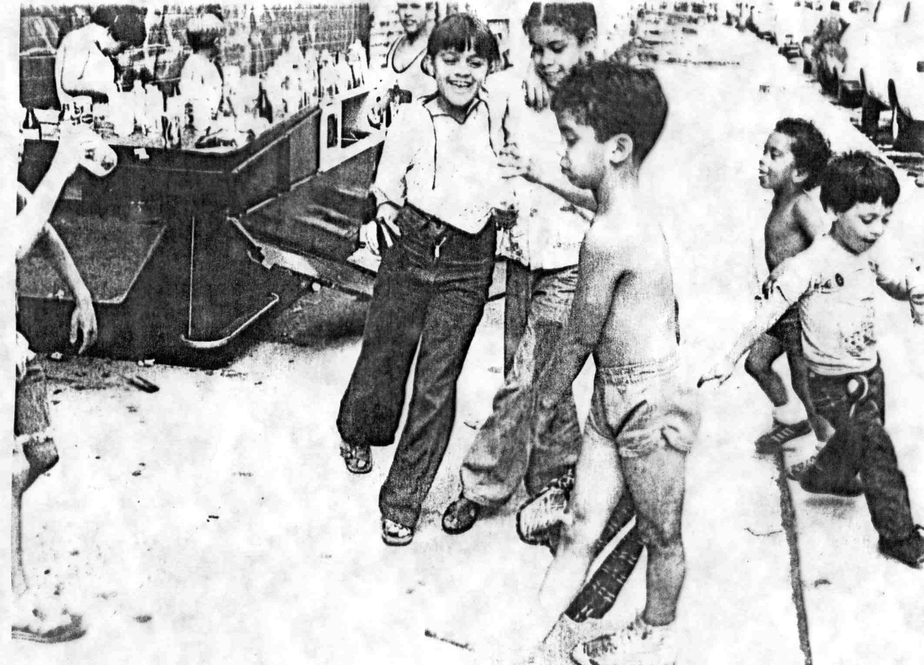
Transformed Identities

Slide 20
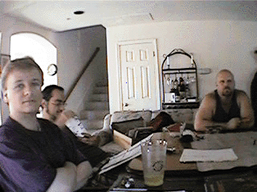
Development of pretend play: later developments
Appears around 1 year
Increases, then
Peaks ~ 3-5 years
  Pretend role play
  Imaginary companion
Developmental fate
  Keep playing
  Daydreaming
  Creative intelligence
  Religious faith

Slide 21
Pretend Play
What is pretend play?
  And why is it interesting?
Development of pretend play
Imaginary companions
Pretend play as coping
Cultural variation

Slide 22

Imaginary companions
Imaginary companion = fantasy friend

Slide 23
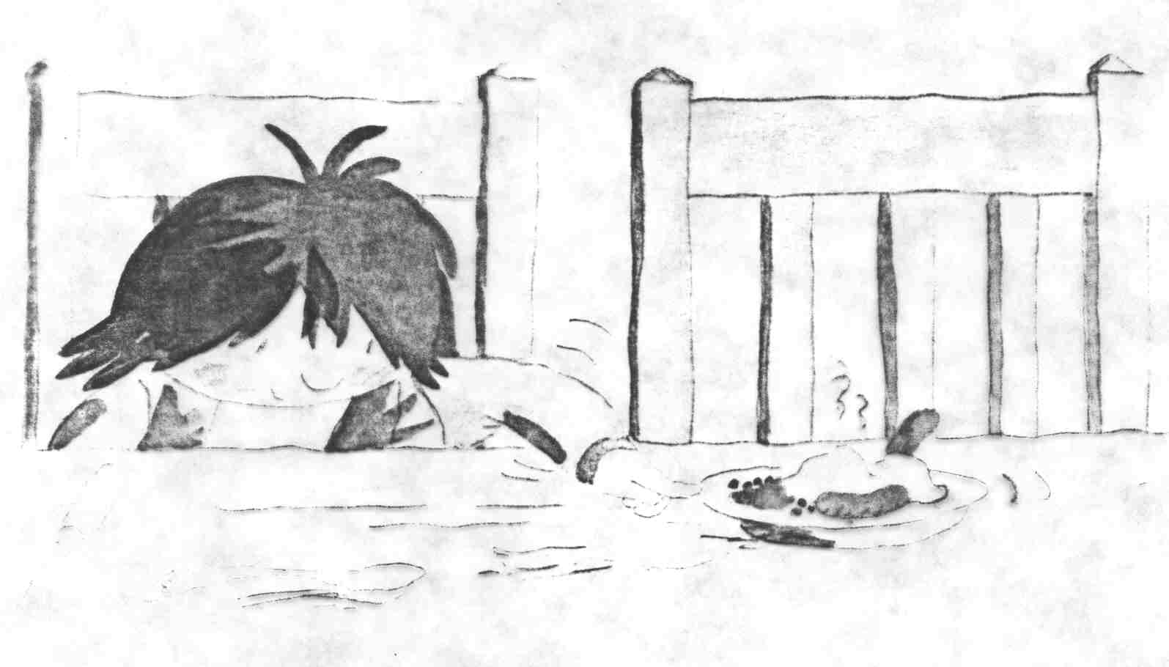
Imaginary companions
Imaginary companion = fantasy friend
  Invisible
  Stuffed Animal

Slide 24
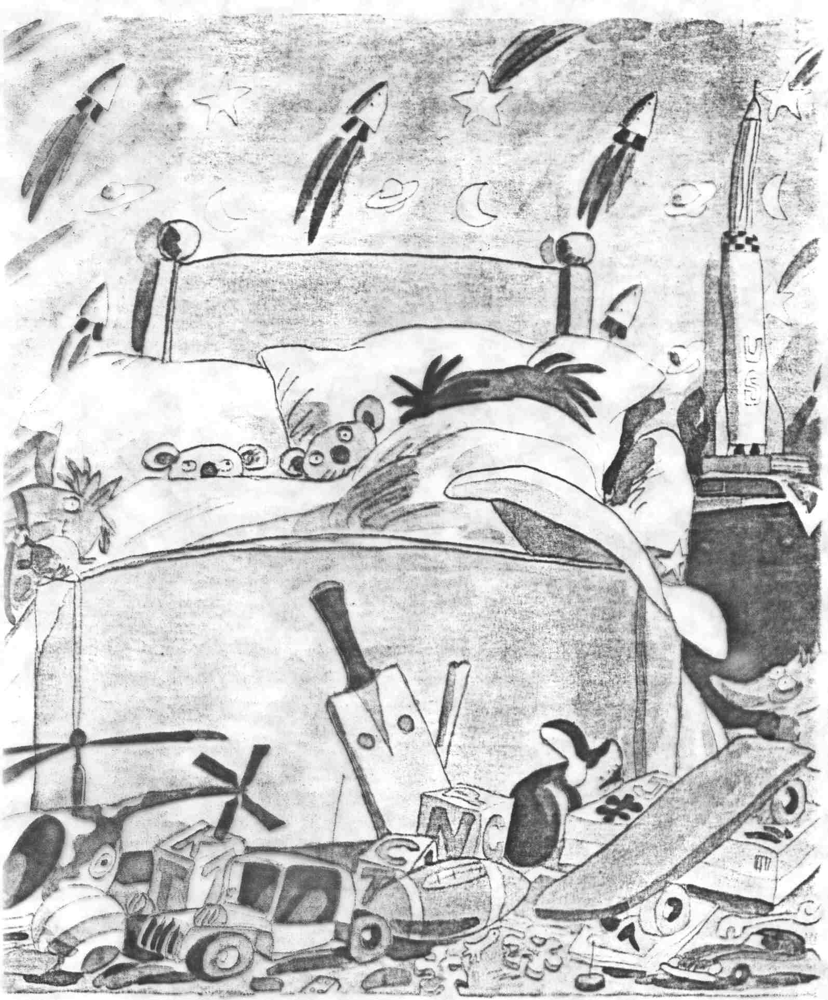
Imaginary companions
Imaginary companion = fantasy friend
  Invisible
  Stuffed Animal

Slide 25
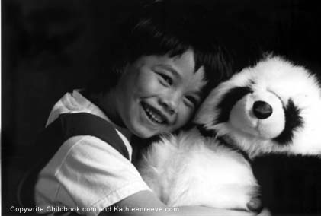
Imaginary companions
Imaginary companion = fantasy friend
  Invisible
  Stuffed animal
    e.g. Calvin & Hobbes

Slide 26
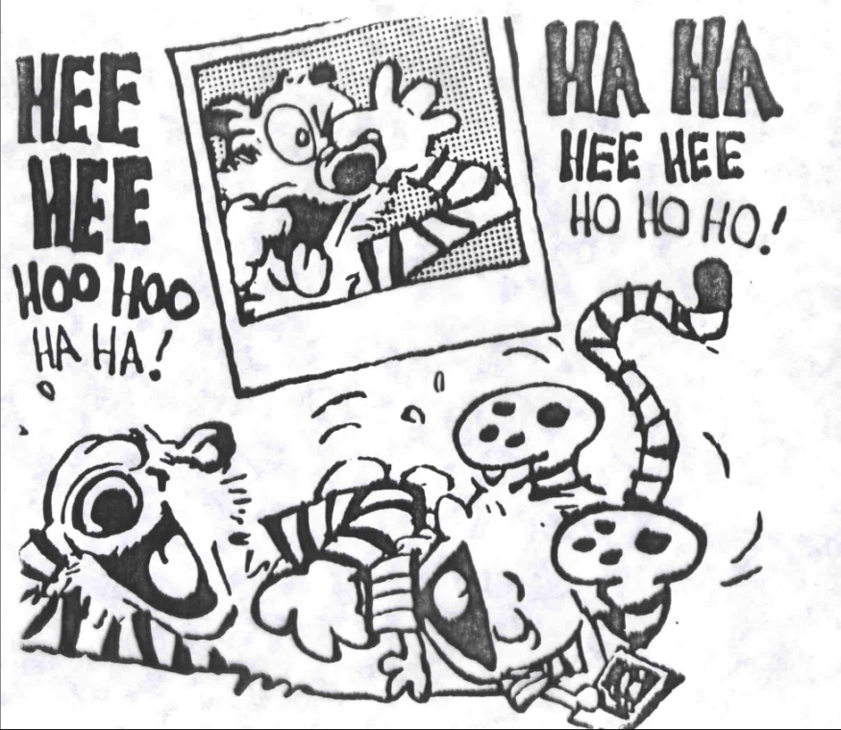
Imaginary companions – definitional issues
Is play with a stuffed animal really an imaginary companion?
Yes, if companion
  Endowed with life-like qualities
  Treated as a friend

Slide 27
Imaginary companions – what do kids do with them
Named
Talked to
Played with
Elaborate, vivid
Enduring

Slide 28
How have researchers studied imaginary companions?
Parental reports
Child interviews
Retrospective reports
50-65% of children studied in U.S. have imaginary companions

Slide 29

Who creates imaginary companions?
MYTH:
  Having an imaginary companion is unhealthy: NO
  A sign of maladjustment: NO

Slide 30
Who creates imaginary companions?
Children with imaginary companions are
  Less shy
  More focused
But children with and without imaginary companions similar in
  Personality
  IQ
  Creativity

Slide 31
Other features of children with imaginary companions
More likely to be
  First-born or only children
  Watch less TV

Slide 32
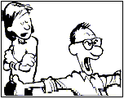
Adult reactions to imaginary companions
Many parents studied in U.S. support them
Adults can promote by
  Respecting child’s inventions
  Making room

Slide 33
Why do children create
Imaginary Companions?
Companionship & fun
Alleviate loneliness
Achieve competence
Overcome limitations
Avoid blame
Help children cope

Slide 34
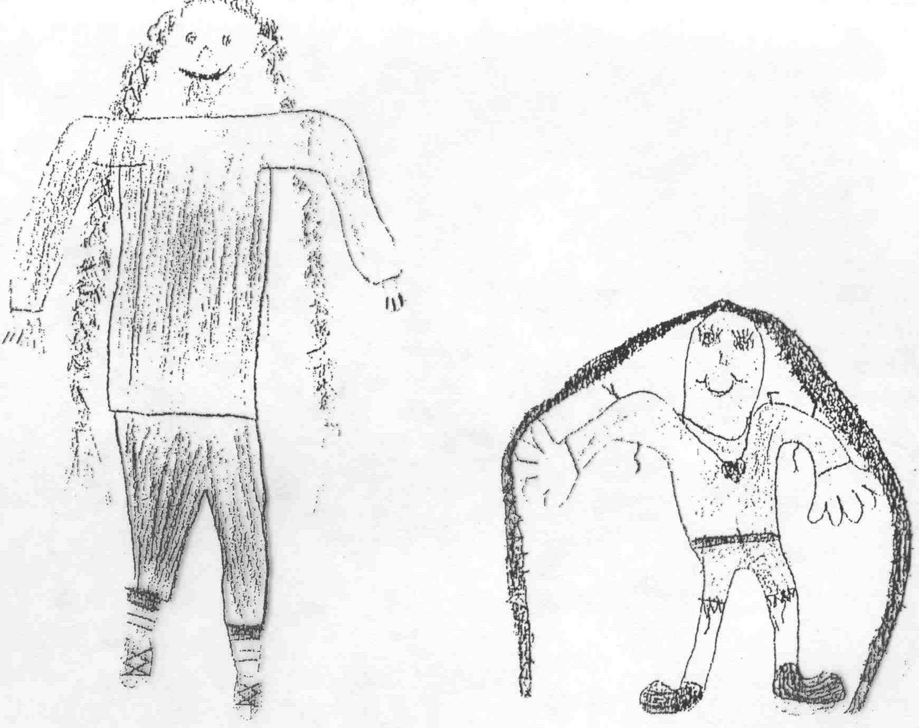
Why do children create
Imaginary Companions?
Companionship & fun
Alleviate loneliness
Achieve competence
Overcome limitations
Avoid blame
Helps children cope
Drawings of Margarine, an invisible girl shared by brother (left drawing) and sister (right drawing)

Slide 35
Pretend Play
What is pretend play?
  And why is it interesting?
Development of pretend play
Imaginary companions
Pretend play as coping
Cultural variation

Slide 36
Pretend play as coping
Play therapy: A therapeutic tool used by therapists working with troubled children
Pretend play as a strategy for everyday coping: Used by children to cope with emotional challenges that arise in daily life

Slide 37
Play therapy
Pretend play can be used in therapy with troubled children who are too young to do talk therapy
Play therapy allows child to act out anxiety, anger, trauma
Child is allowed to choose toys to play with while therapist observes and makes appropriate comments to elicit feelings
Toys: doll house, dress-up clothes, puppets, blocks, miniature figures and vehicles, etc.

Slide 38
Origins of play therapy (Singer, 2009)
Offshoot of psychoanalytic movement in Western Europe in early 20th century
Melanie Klein & Anna Freud pioneered
Goal was to establish rapport with the troubled child and to uncover conflicts and maladaptive ways of coping
Has spread widely
Now often used in conjunction with other techniques

Slide 39
Pretend play as everyday coping
In Sickness and in Play: Children coping with chronic illness by Cindy Dell Clark (2003)
  5- to 8-year-old children
  diabetes or severe asthma
  used play to help themselves cope with the daily challenges of scary illnesses and medical procedures

Slide 40
Example 1 of everyday coping: Randy
Randy (5 years old) had severe asthma for his whole life
He had a special attachment to toy cars. He played with them when he was ill, and they helped him cope with fear and suffering
In interviews, Randy imputed magical qualities to his race cars, said that they “worked wonders”
He said that his race car could make medicine taste better

Slide 41
Randy (continued)
He claimed not even to feel a shot when his race car was with him
His mother confirmed that when Randy was allowed to hold his race car at the hospital emergency room, it calmed him, acting as a “godsend.”
His mother kept a race car at hand at all times and sent one along to school with him
BUT Randy was not allowed to have the car with him when he had an X-ray

Slide 42
Example 2 of everyday coping: Peter
Peter (7 years old) severe asthma since 3
In an interview, he was asked to draw a picture of “the worst time you ever remember, with your asthma”
He drew a picture of himself sick in bed, with a frown on his face
Then he added the sheets on his bed, which were decorated with superhero characters (Teenage Mutant Ninja Turtles)
Then he erased the frown and drew a smile on his face

Slide 43
Peter (continued)
Peter was anxious about becoming sick at night, alone in his room and unable to breathe or get help
But he expected the Teenage Mutant Ninja Turtles to be strong enough to protect and help him
He said, “Nothing can harm ’em.” They can help people with asthma but never get asthma themselves

Slide 44
Example 3 of everyday coping: Grace
Grace (7 years old) was diabetic, diagnosed at 22 months.
She told the interviewer what happened when she was hospitalized (at 22 months), also drew a picture
Prominent in the picture was a large stuffed tiger, next to Grace’s “jail bed”
The hospital and hurtful procedures scared her

Slide 45
Grace (continued)
Grace: I hated lying in that bed…and I had a tiger. My uncle got…it. It’s like a huge tiger. The nurses used to take it away because they thought it would scare me. But it didn’t. (Sobs for several minutes). And I was only two years old.
CDC: How did the tiger make you feel?
Grace: It made me feel safe.
CDC: Really? How come?
Grace: It kept me company.

Slide 46
Grace (continued)
Grace’s coping was misinterpreted and impeded by those taking care of her.
A lack of understanding led to unnecessary emotional trauma

Slide 47
Examples of adults supporting coping through play
A mother and her 5-year-old diabetic son shared in pretend play during each insulin injection by imagining that the syringe was a zebra
The mother pretended that the zebra “kissed” the boy when injecting him (transformed the injection into an act of love)
The boy was allowed to hit or dismantle the “bad” zebra after the injection (an outlet for his negative feelings)

Slide 48
Another example of adults supporting coping through play
The director of a summer camp for children with asthma brought two stuffed animals to camp: Ally Alligator and Monique (a dog)
The director told the children that both animals had asthma
The children enjoyed taking care of them
A group of 10 year old girls: “We played with them through lunch and made sure that they were safe and took charge of them….Ally swallowed a watermelon seed during lunch, and Monique got a bee sting.”

Slide 49
Pretend Play
What is pretend play?
  And why is it interesting?
Development of pretend play
Imaginary companions
Pretend play as coping
Cultural variation

Slide 50
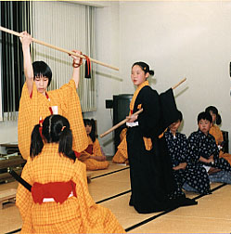
Cultural variation in pretend play
Burgeoning of cross-cultural research in last 20 years

Slide 51
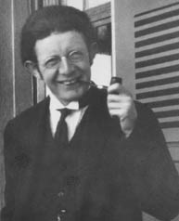

Is pretend play a sociocultural activity?
Piaget: NO
  Child = scientist
  Pretend play = mastery of universal concepts
  Consolidation
Vygotsky: YES
  Child = social being
  Pretend play = culturally shaped (econ., history)
  Cultures select tasks, partners, provide artifacts

Slide 52
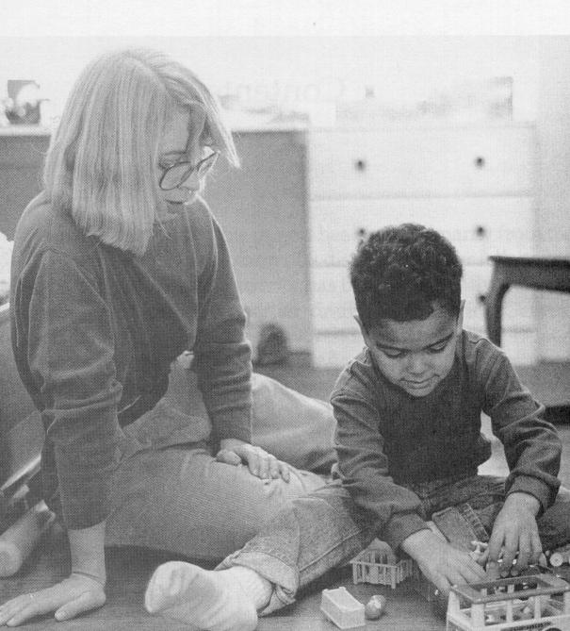
One cultural case: middle-class E-A
Everyday Pretending at Home (Haight & Miller, 1993)
  Content: realistic & fantasy
  Primary partner: Mom (1-3 yr)
  Mothers prompted, elaborated, directed, modeled
  Resources: lots of toys, time, space
  Parental beliefs: pretend play important
  Part of domestic activity, not part of economic sphere

Slide 53

Another cultural case: Yucatec Maya (Mexico)
Content: realistic, not fantasy, no imaginary companions
Participants: older children
Adults do not encourage, supervise, participate
Resources: few objects, little time for play
Adults value play because it let’s them work
Productive labor valued by parents and children; children contribute to
Children learn by observing
Children remarkably motivated, competent
Suzanne Gaskins

Slide 54
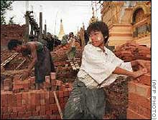
Cultural variation: putting universals and differences together
Growing evidence of universals:
Children everywhere engage in pretend play
Children everywhere reach out for the activities their parents offer

Slide 55
Cultural variation: putting universals and differences together
Growing evidence of differences:
*Pretend play takes radically
different forms in children’s lives
amount
when it peaks
realistic/fantasy
how learned
*Pretend play serves different functions and meanings and inculcates different values

